Slide 1

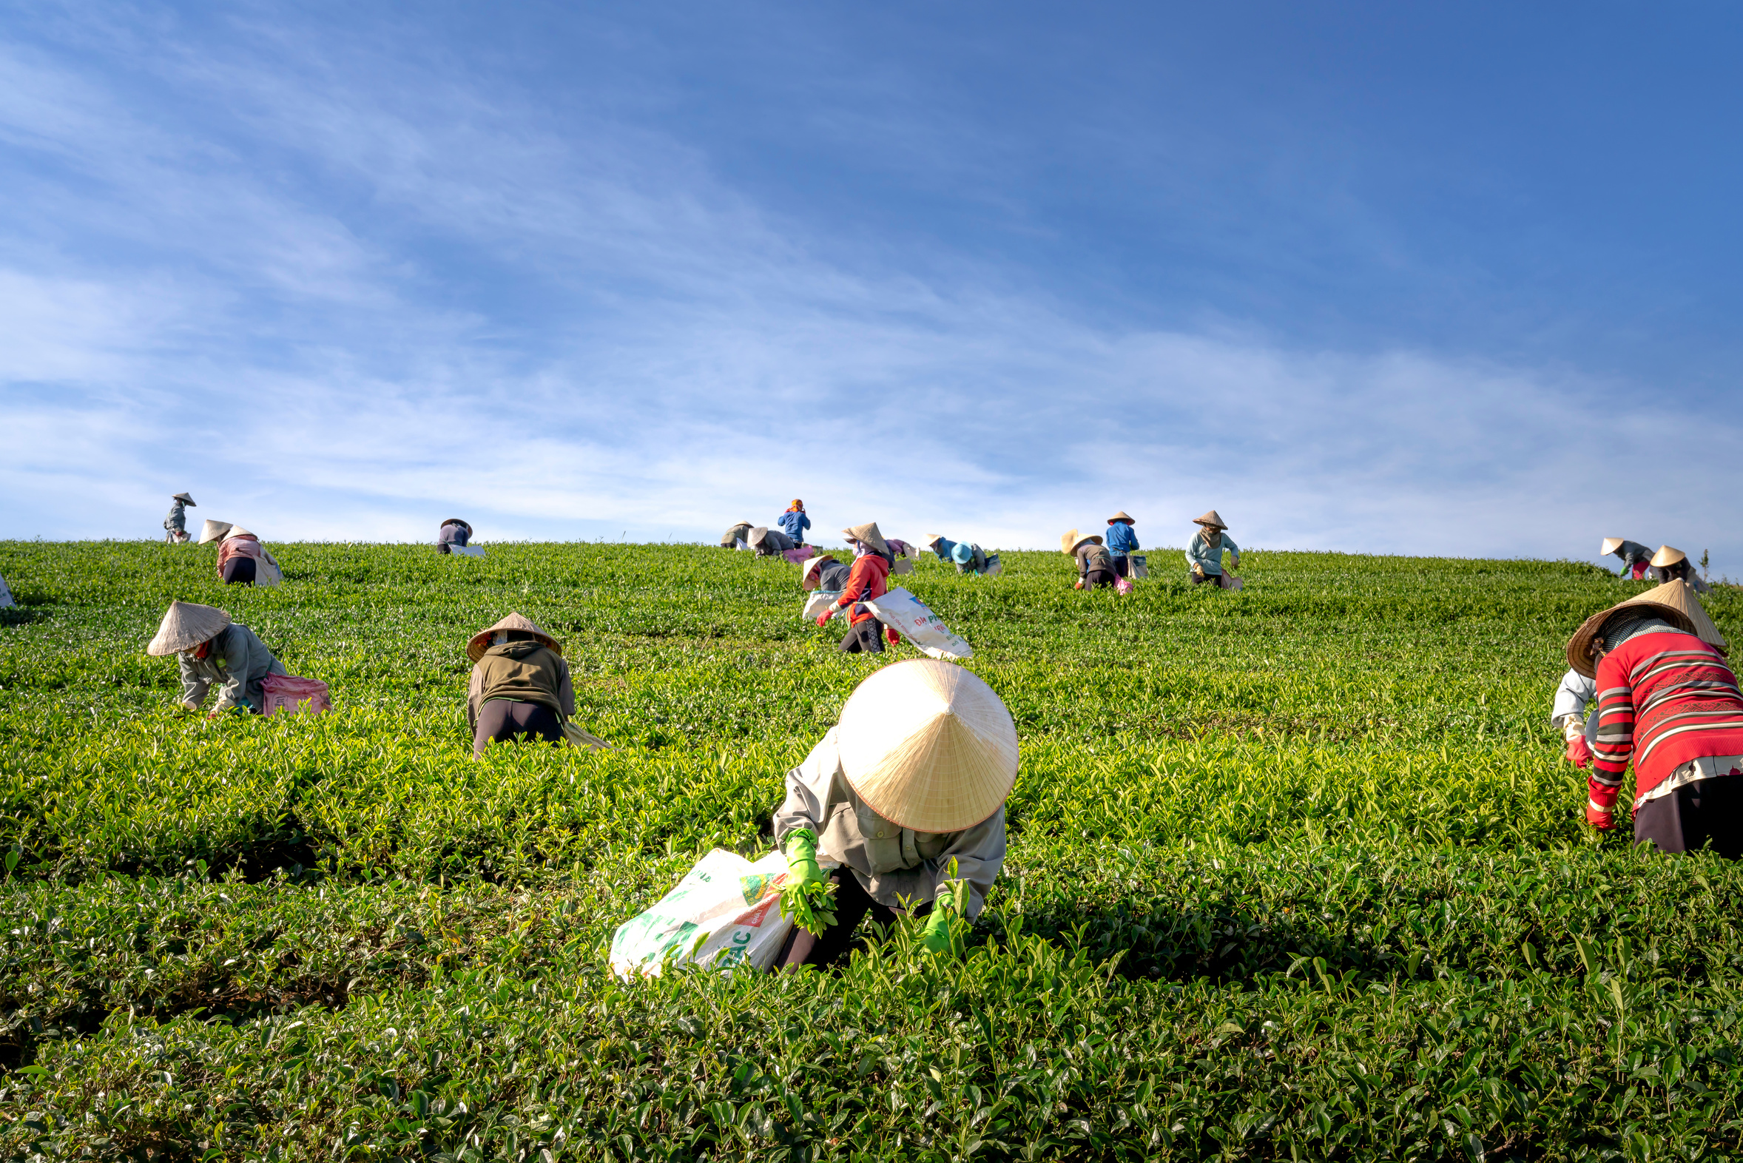

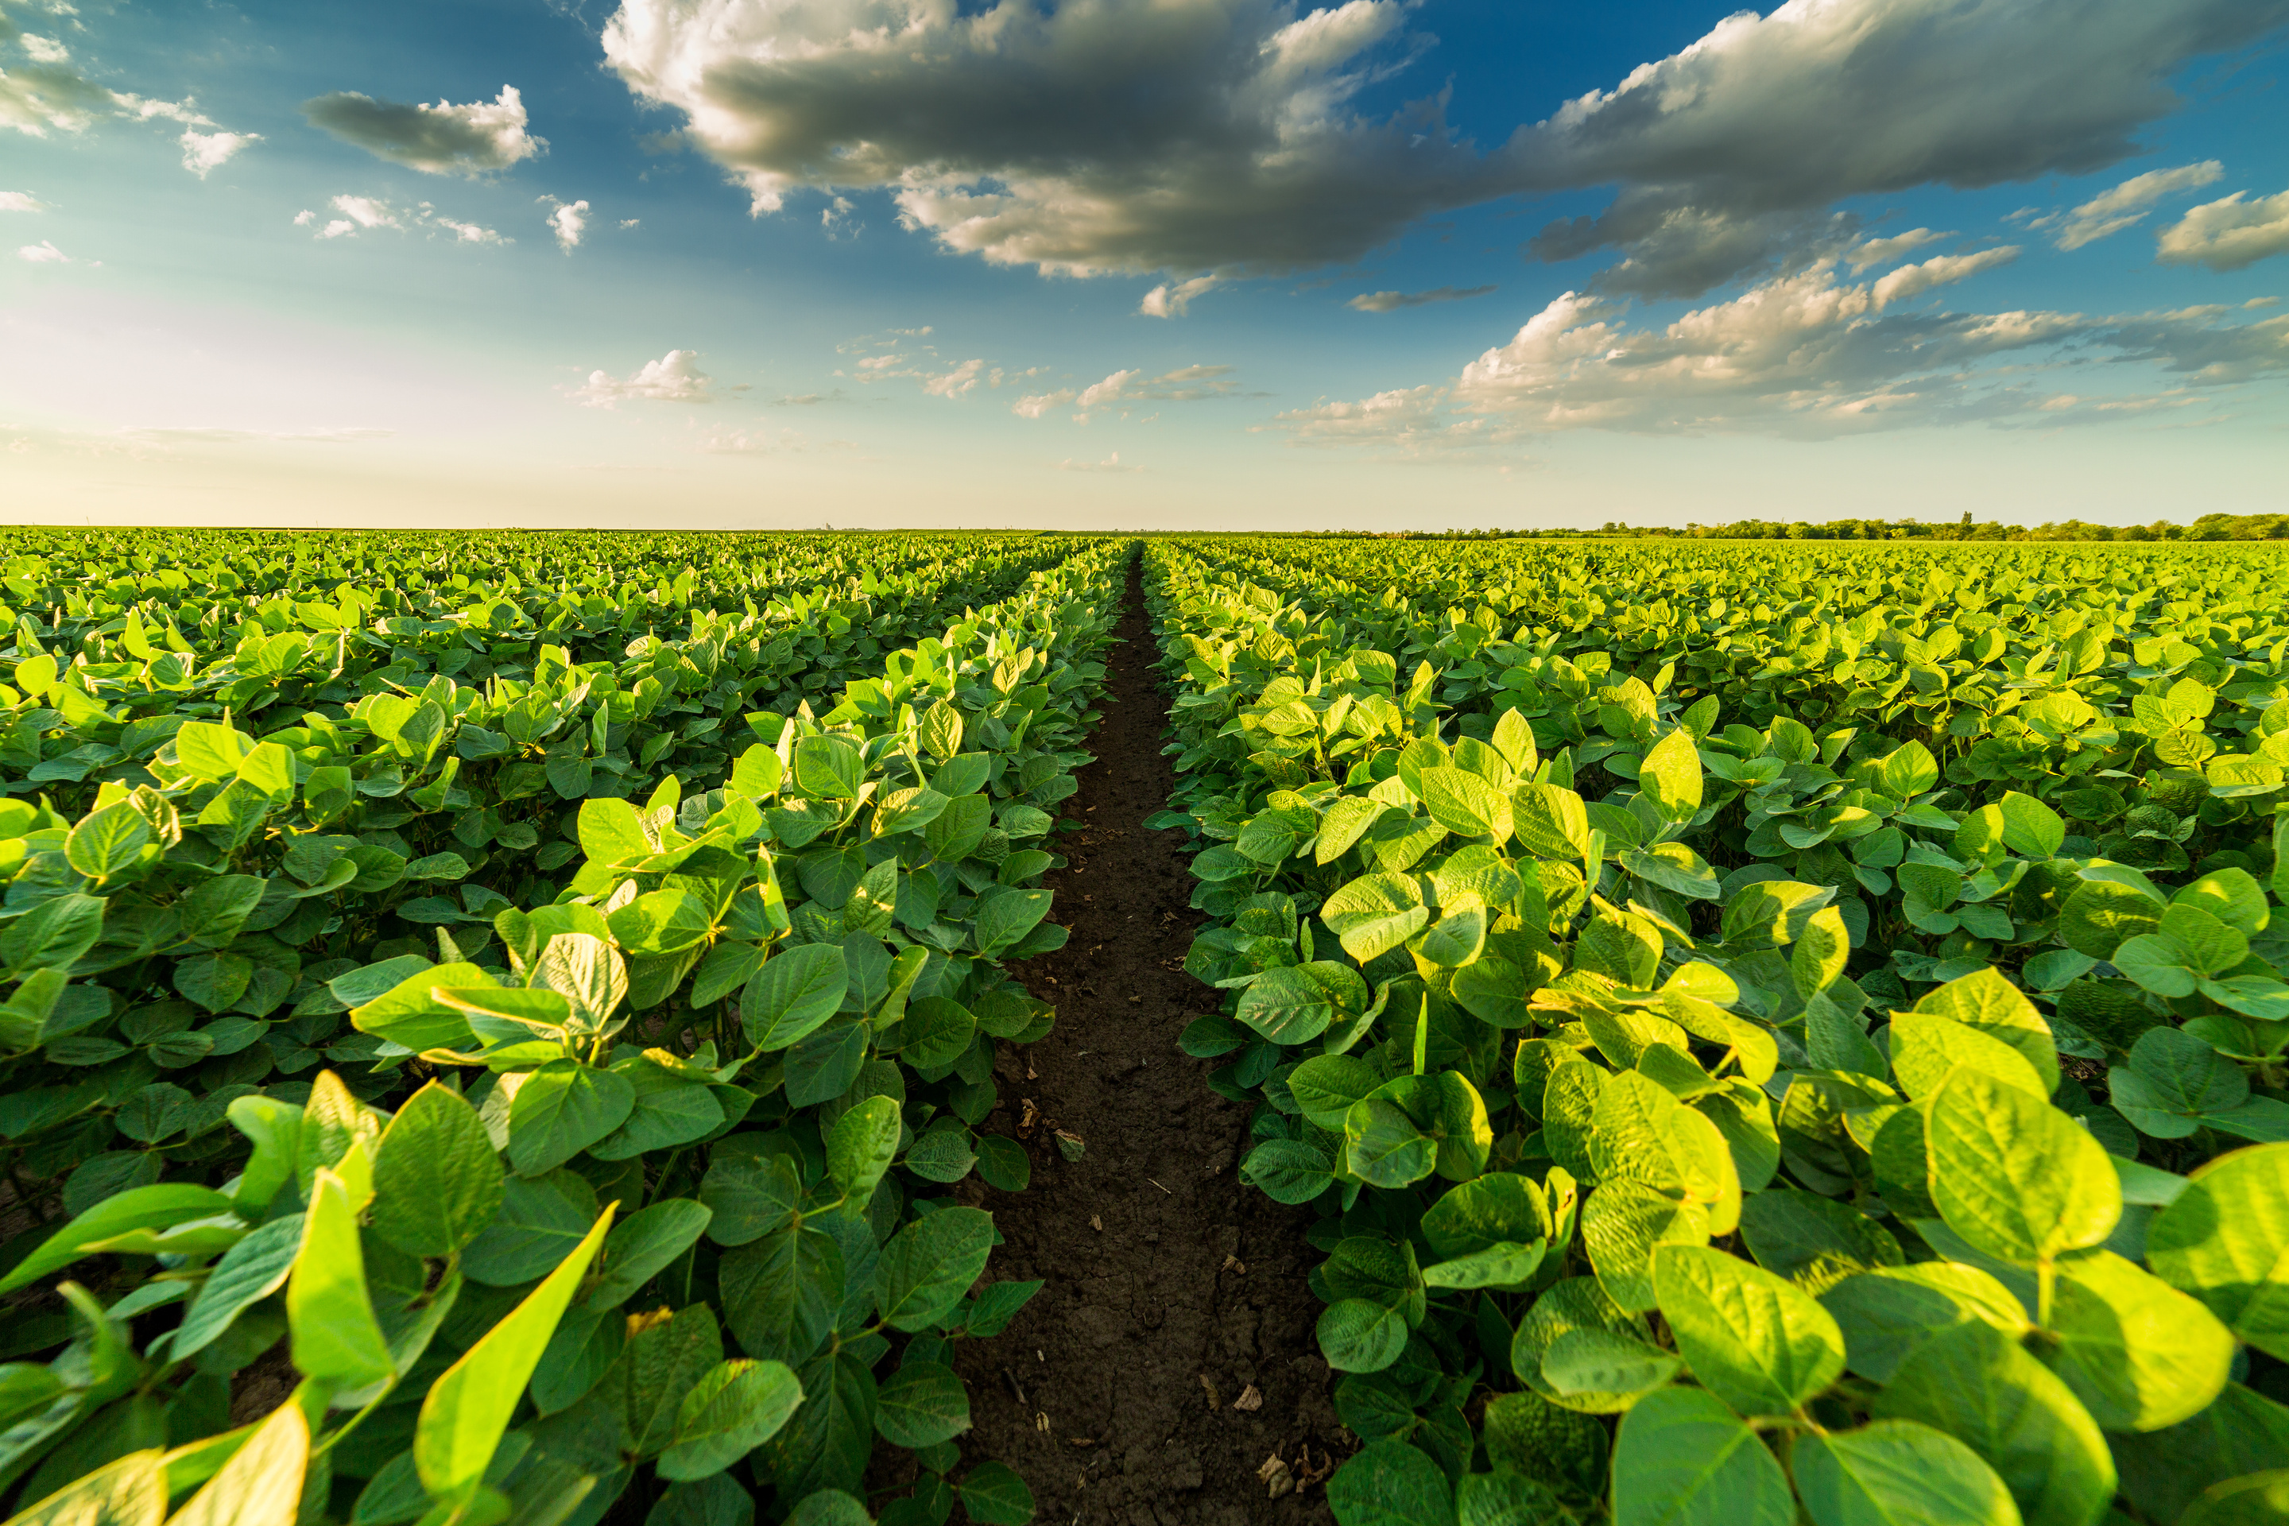


Company
Country of origin
Slogan about naturalness / traditions
Contact person
Website:
Ivan Ivanov
yourcompany.com

Slide 2



Company description
Example: The company is an agricultural enterprise from Kyrgyzstan, engaged in cultivating eco-friendly products and developing agribusiness. In our work, we combine traditional methods with modern technologies to achieve high-quality harvests and ensure sustainable development.
About us
Geography / Export countries
Example: The company’s products are supplied not only to the domestic market of Kyrgyzstan but are also exported to neighboring and distant countries. The main export destinations include Central Asian states, as well as Russia, Kazakhstan, and Uzbekistan. Thanks to the high quality of our products and compliance with international standards, the company is gradually expanding its geography of supply, entering the markets of the Middle East and Europe.
Company
Year of establishment

Slide 3





Mission / Values
Philosophy:
Executive
quote
Example: We build our business on the principles of honesty, responsibility, and sustainable development. For us, it is important not only to ensure the quality of our products but also to care for the environment, support local communities, and contribute to the development of the country’s agriculture.
Example: "Our company grows together with Kyrgyzstan. We are confident that combining traditions with modern technologies will help us create products we can be proud of on the global market."

Slide 4


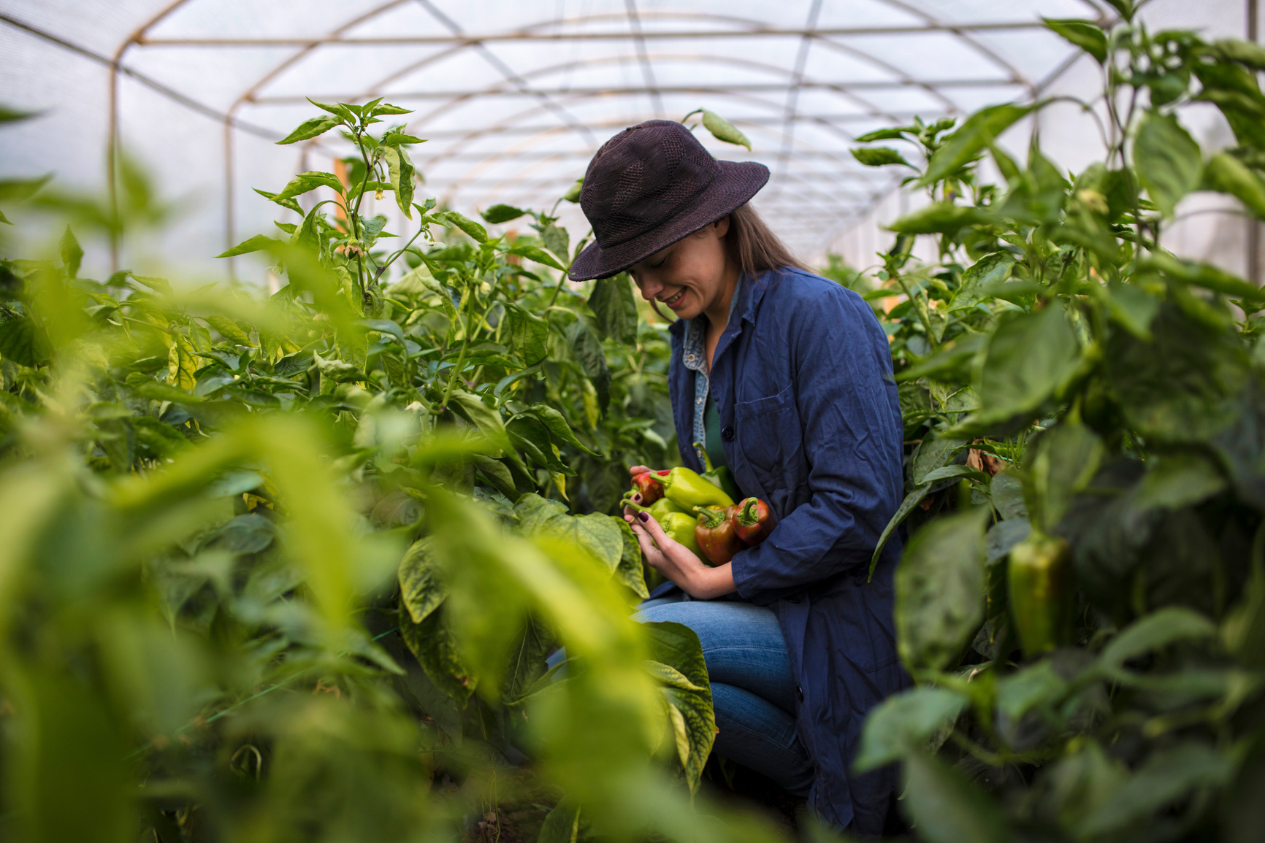

1
Organic, non-GMO
2
Stable supplies
Key
advantages
Certification:
ISO, Organic, Halal
3
Quality assurance, logistics
4

Slide 5


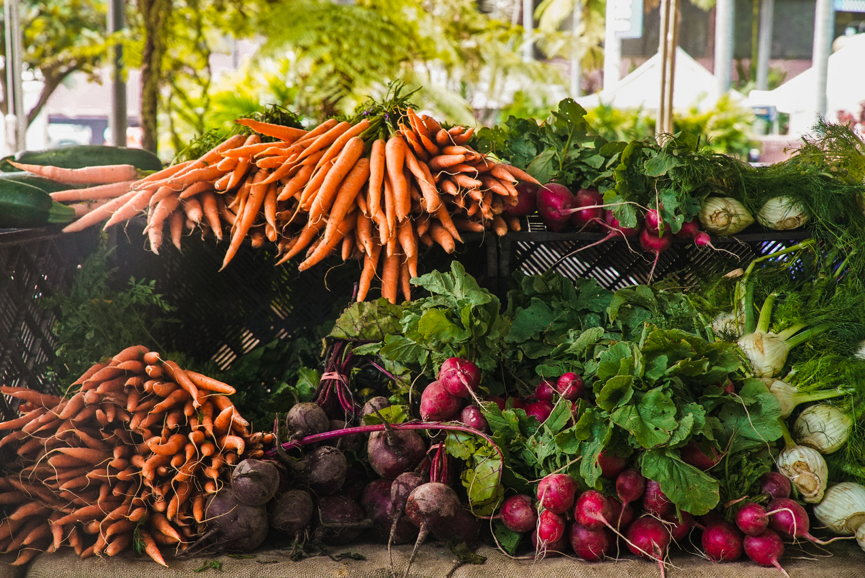



Products
1
Product 1
3
Product 2
Example: Fresh vegetables grown in the eco-friendly conditions of Kyrgyzstan.
Example: Natural dairy products preserving traditional flavors.
2
Product 3
4
Product 4
Example: High-quality meat products for domestic and international markets.
Example: Grain crops meeting modern quality and safety standards.
website:
yourcompany.com

Slide 6


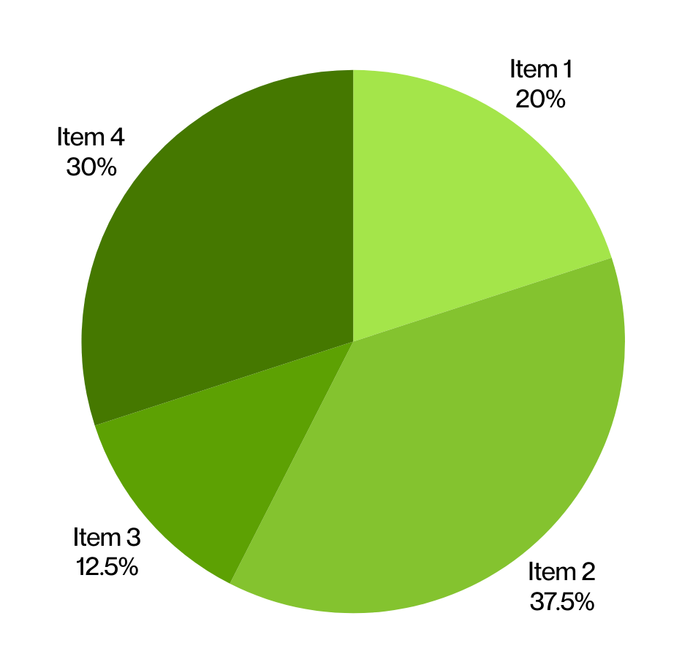

Production
capacities
500
Scale (hectares)
200 К
Volumes (tons per year)
100%
Quality control
500
Turnover (million per year, KGS)

Slide 7
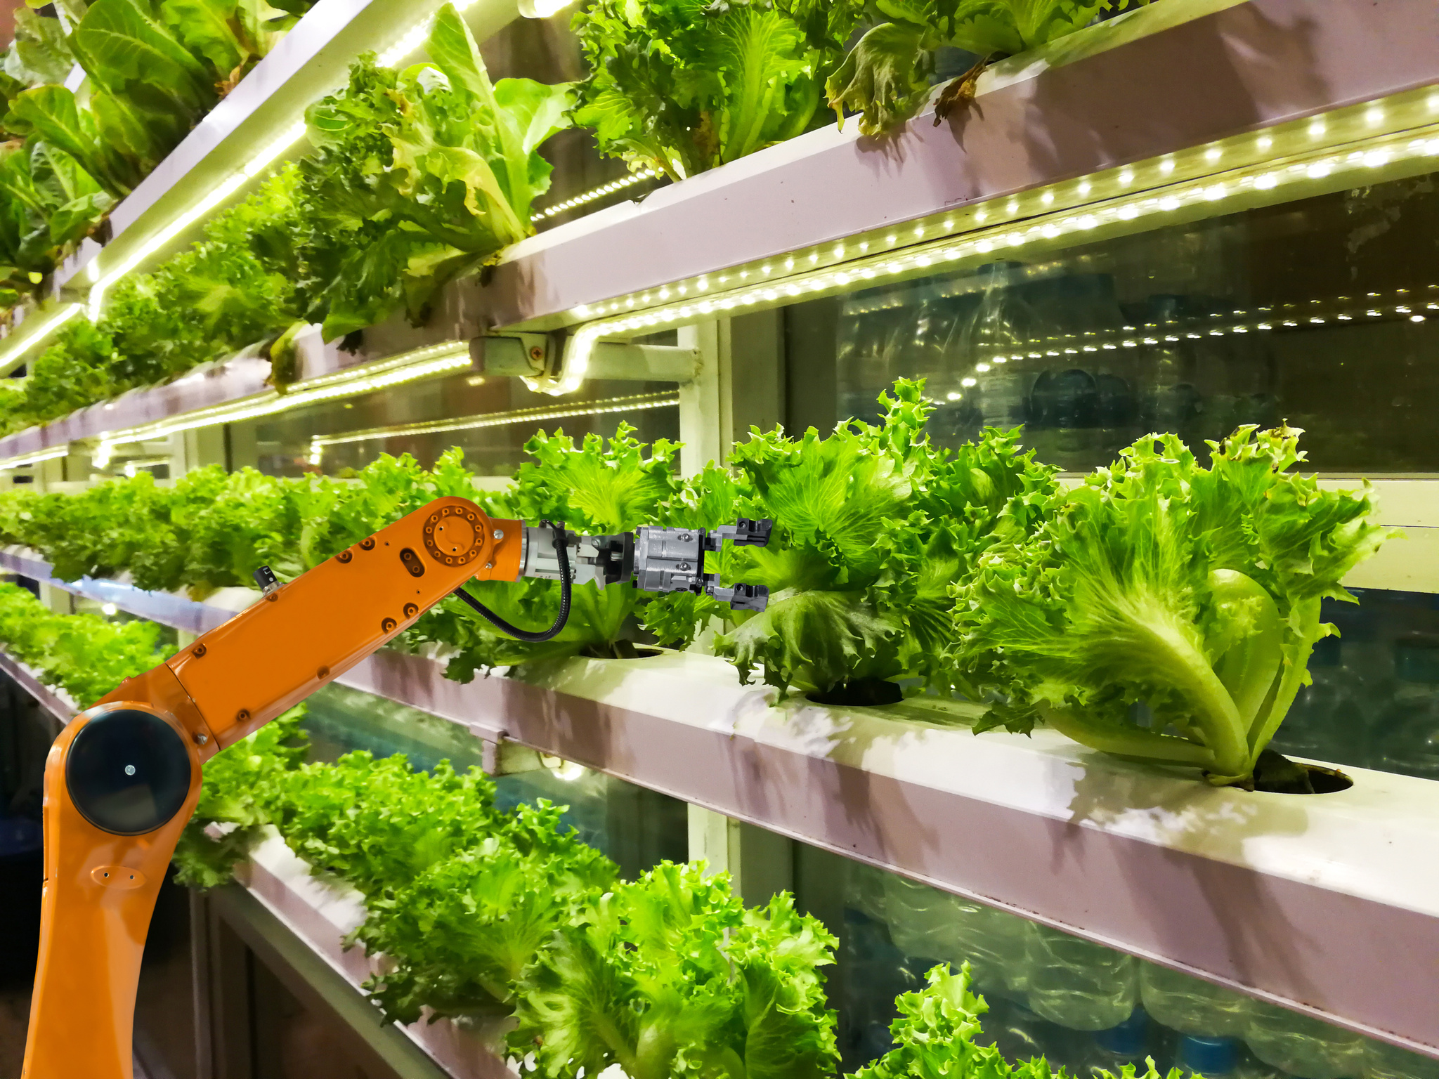
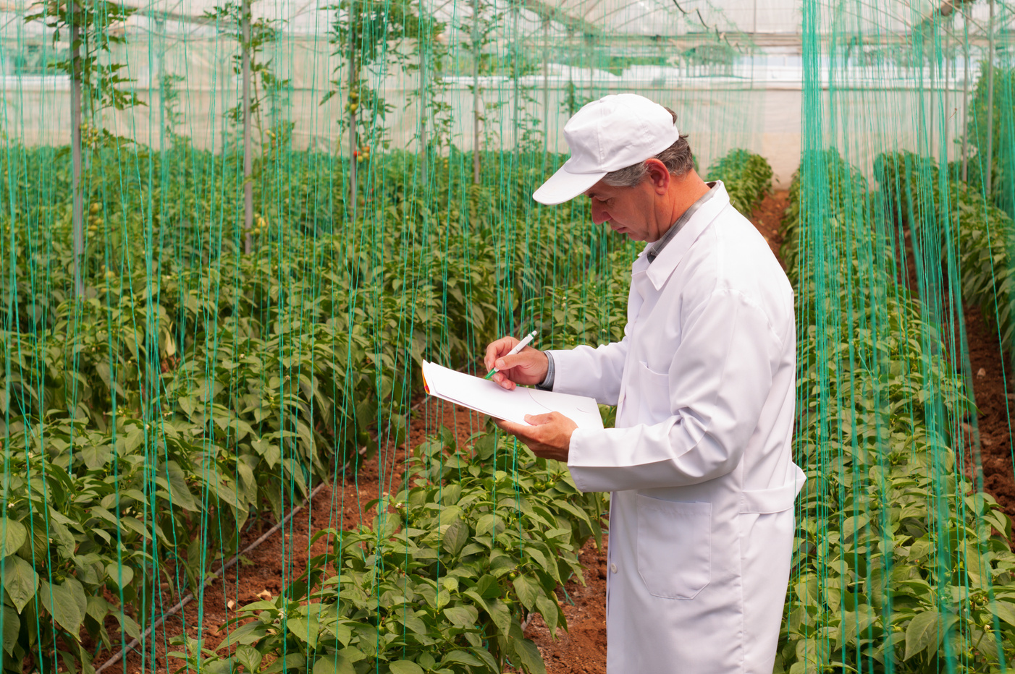



Partner
portfolio
100+
Volumes
50+
Countries
800+
Reviews
500+
Deliveries

Slide 8
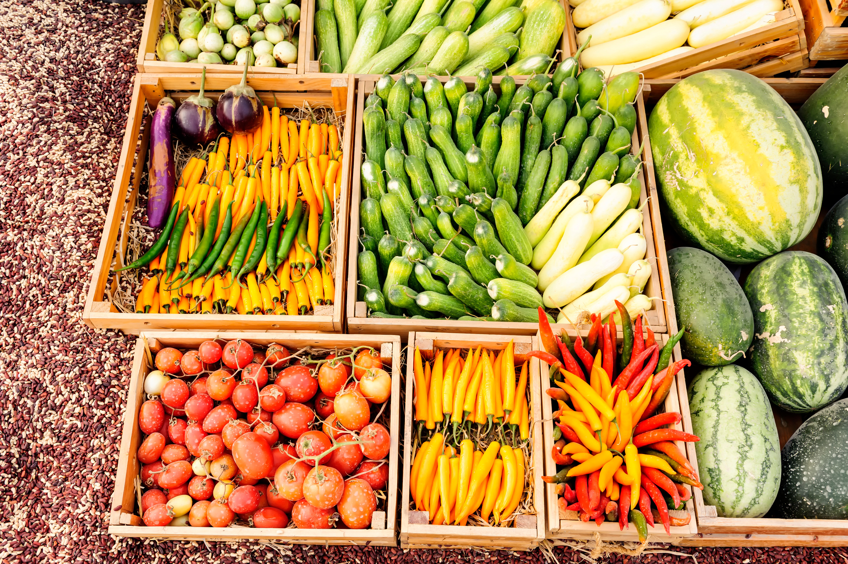
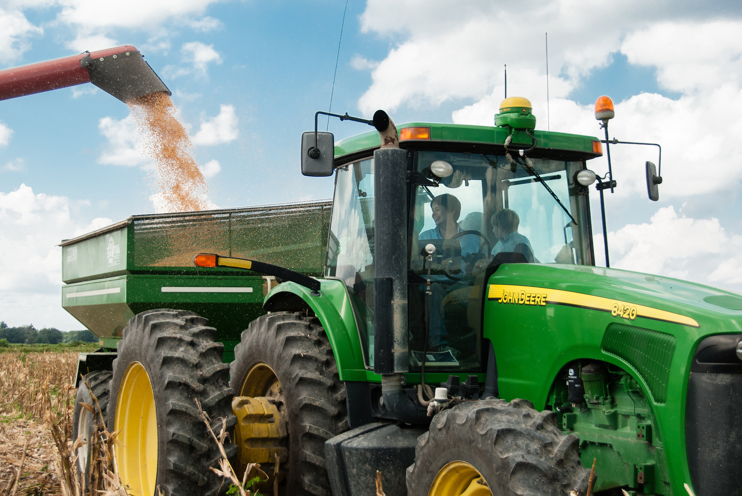


Terms
of cooperation
1
Inquiry / Request
MOQ:
Minimum order quantity
2
Contract / Agreement
Incoterms:
Delivery terms
3
Shipment
Deadlines:
Order fulfillment time

Slide 9
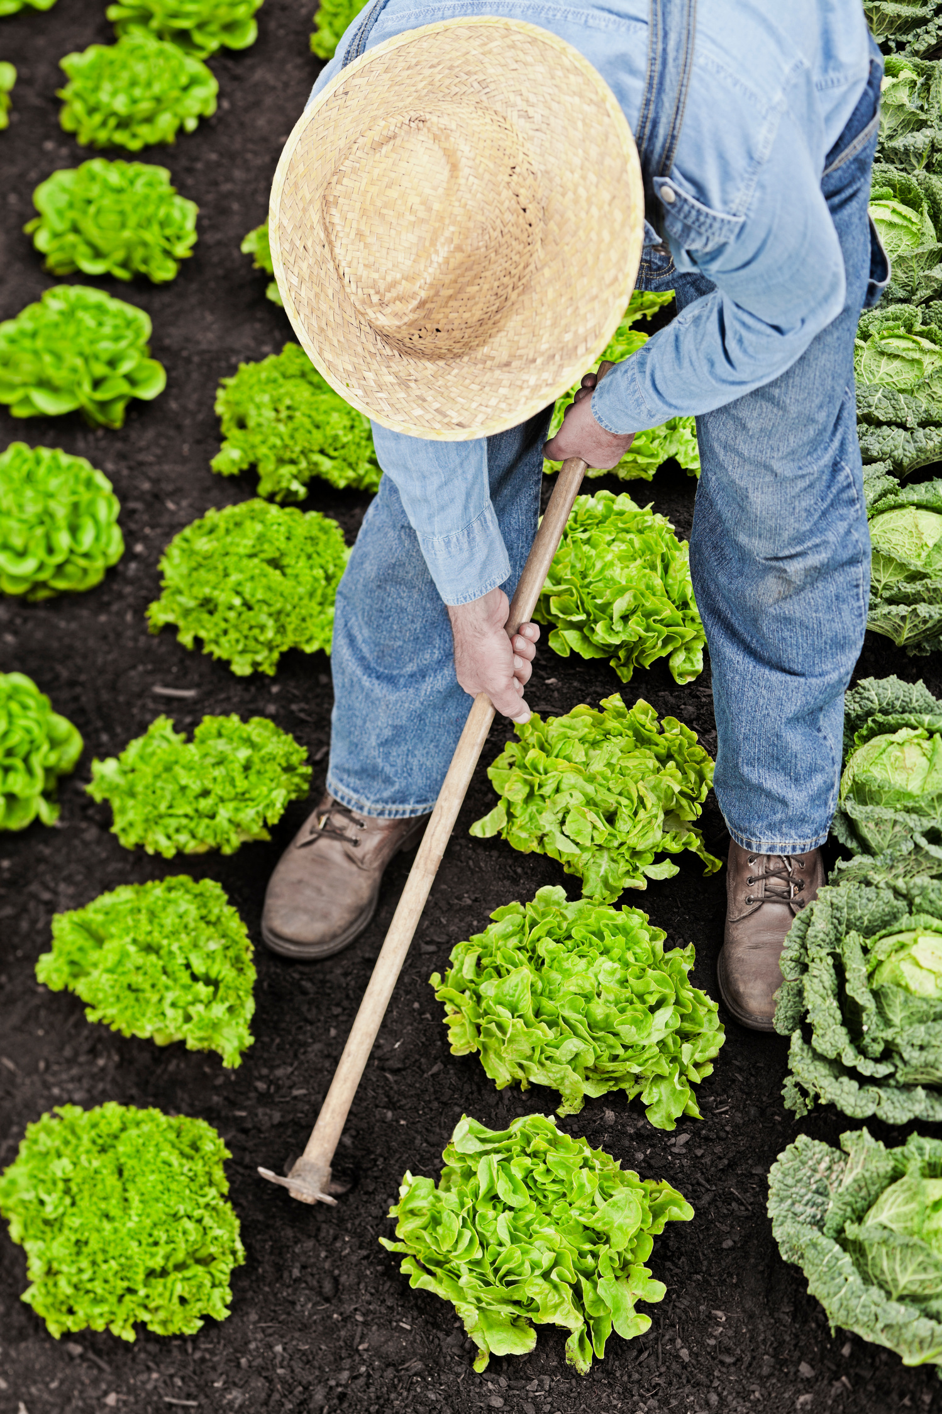







Thank you
for your attention
Ivan Ianov, Project Manager
Company
Contacts
Phone:
Adress:
+996 XXX XXX XXX
Bishkek, 88 Primernaya str.
Website:
Email:
yourcompany.com
hello@yourcompany.com

