Slide 1
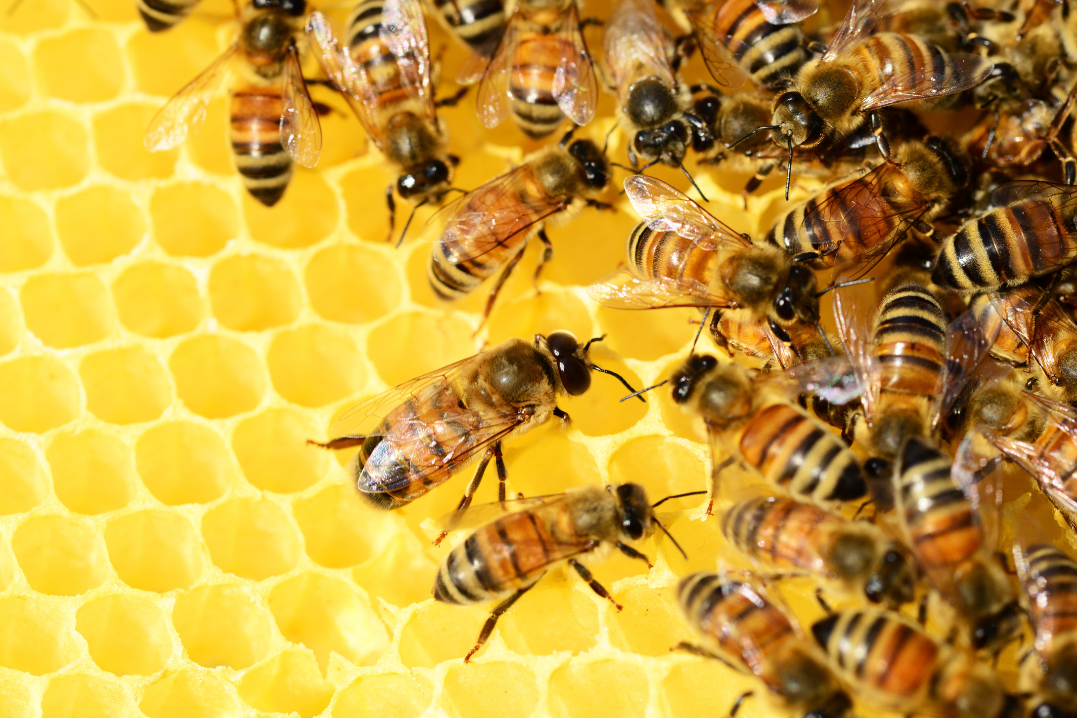

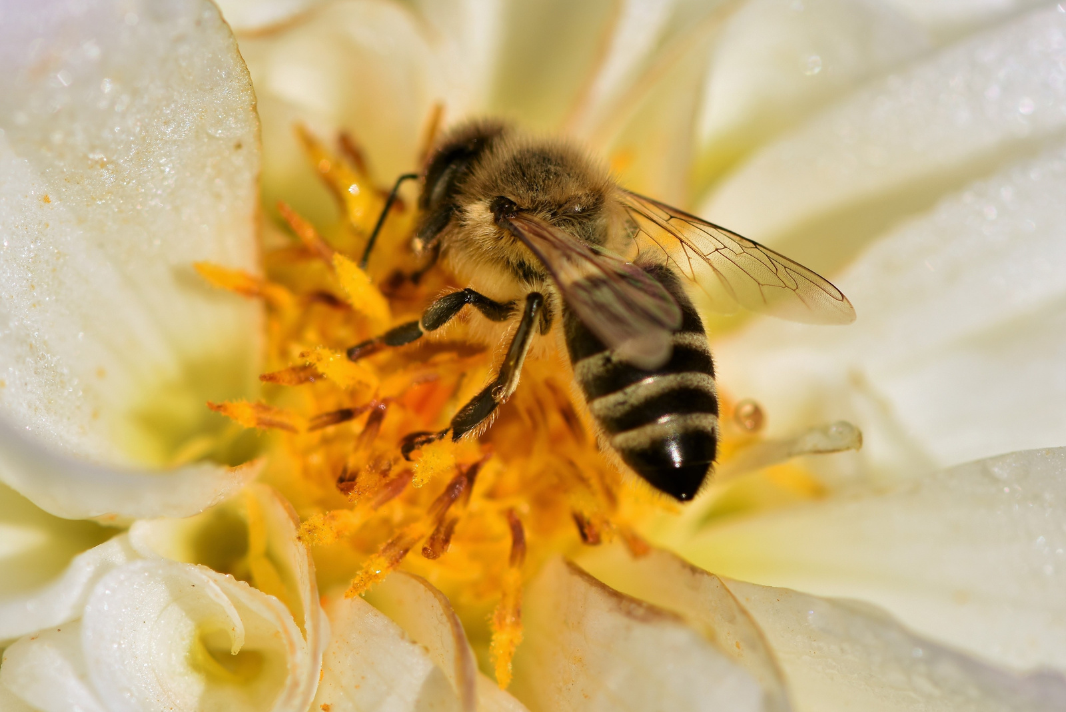

Place for Logo
Slogan:
100% Natural Honey from Beekeepers
Company Name
Country of Origin
www.yourcompany.com

Slide 2

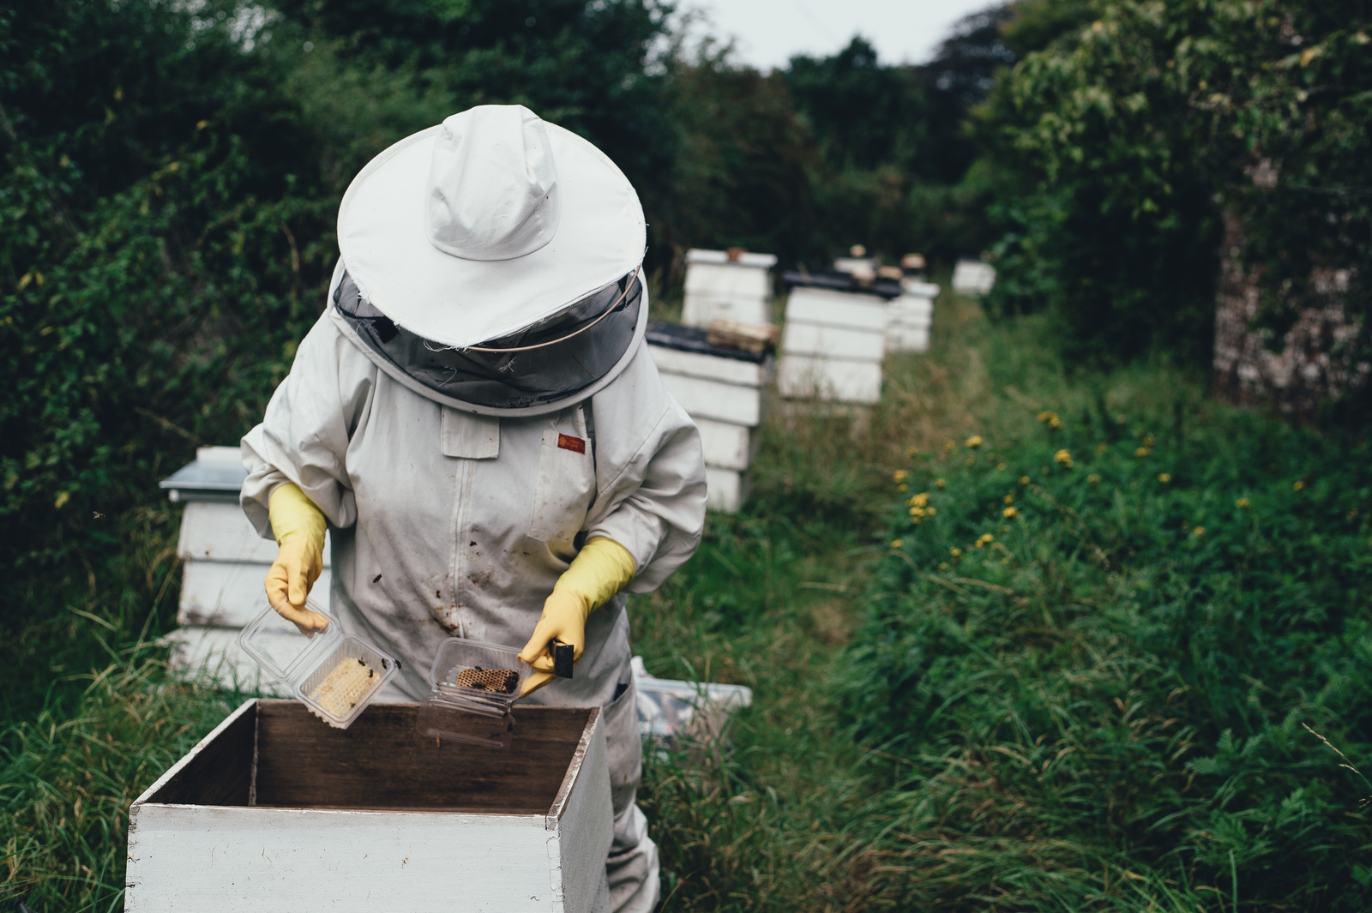
Place for Logo
About us
We are a producer of natural honey with many years of history. Our apiaries are located in ecologically clean regions, which allows us to produce high-quality honey. We specialize in different types of honey, offering a wide range of products.
Export Geography
We take pride in our brand and production process — from hives in blooming fields to the packaging of the final product.
Our products are exported to many countries worldwide, confirming their high quality and compliance with international standards.

Slide 3
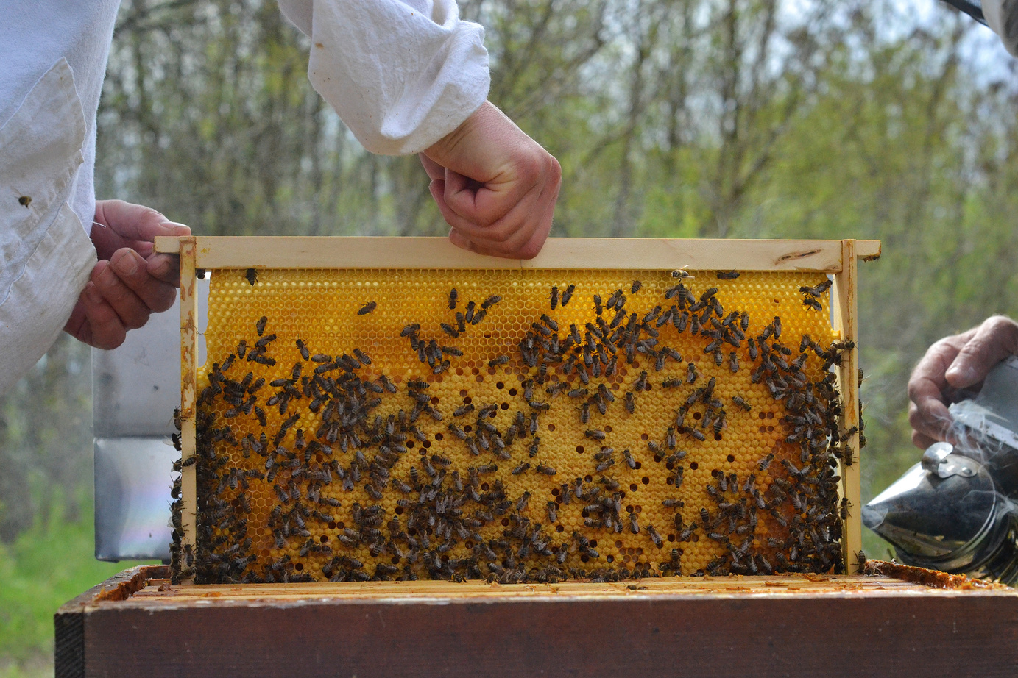
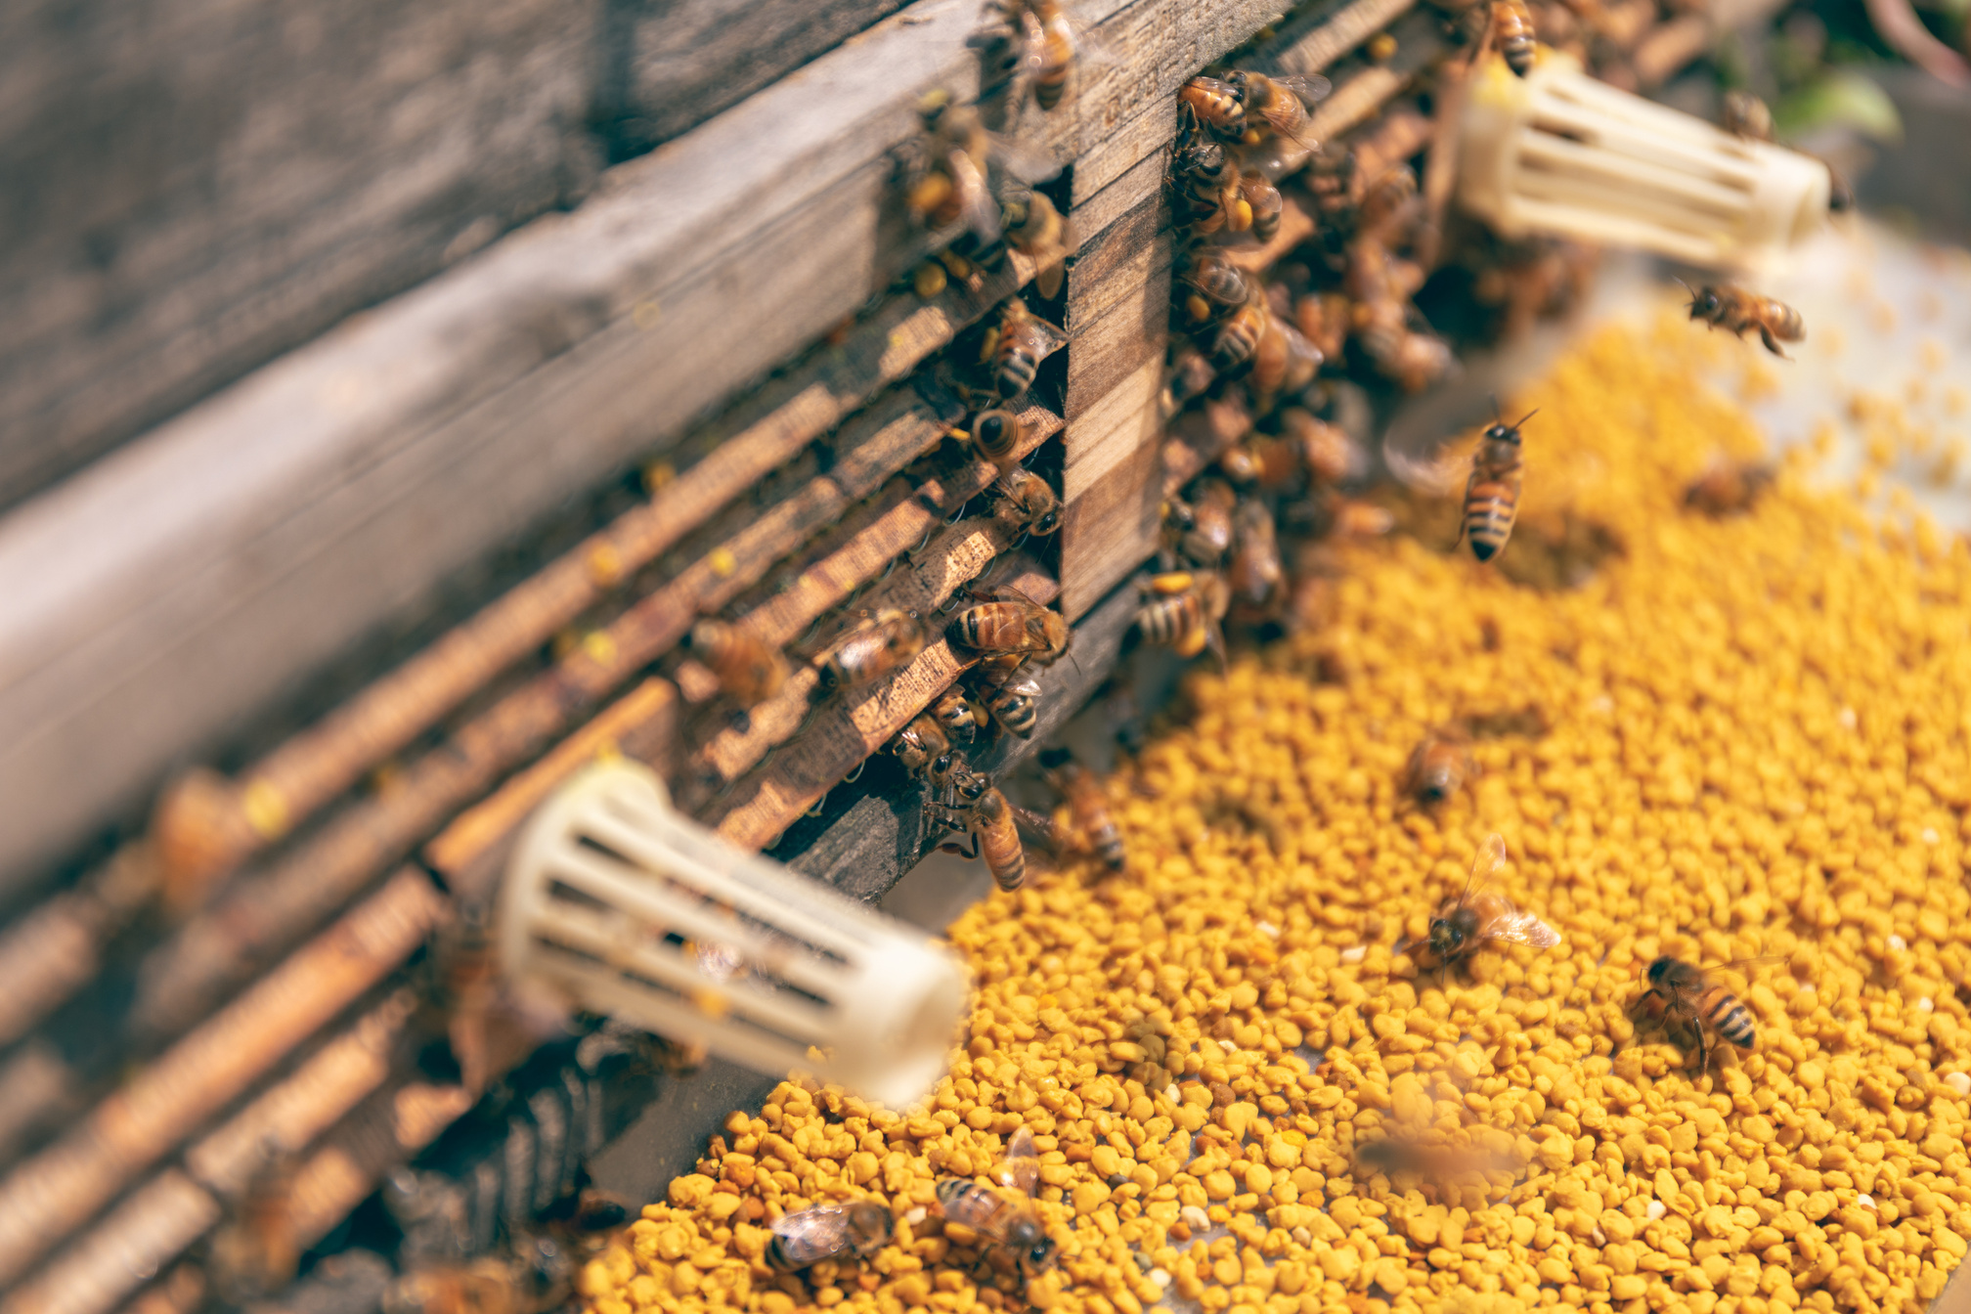
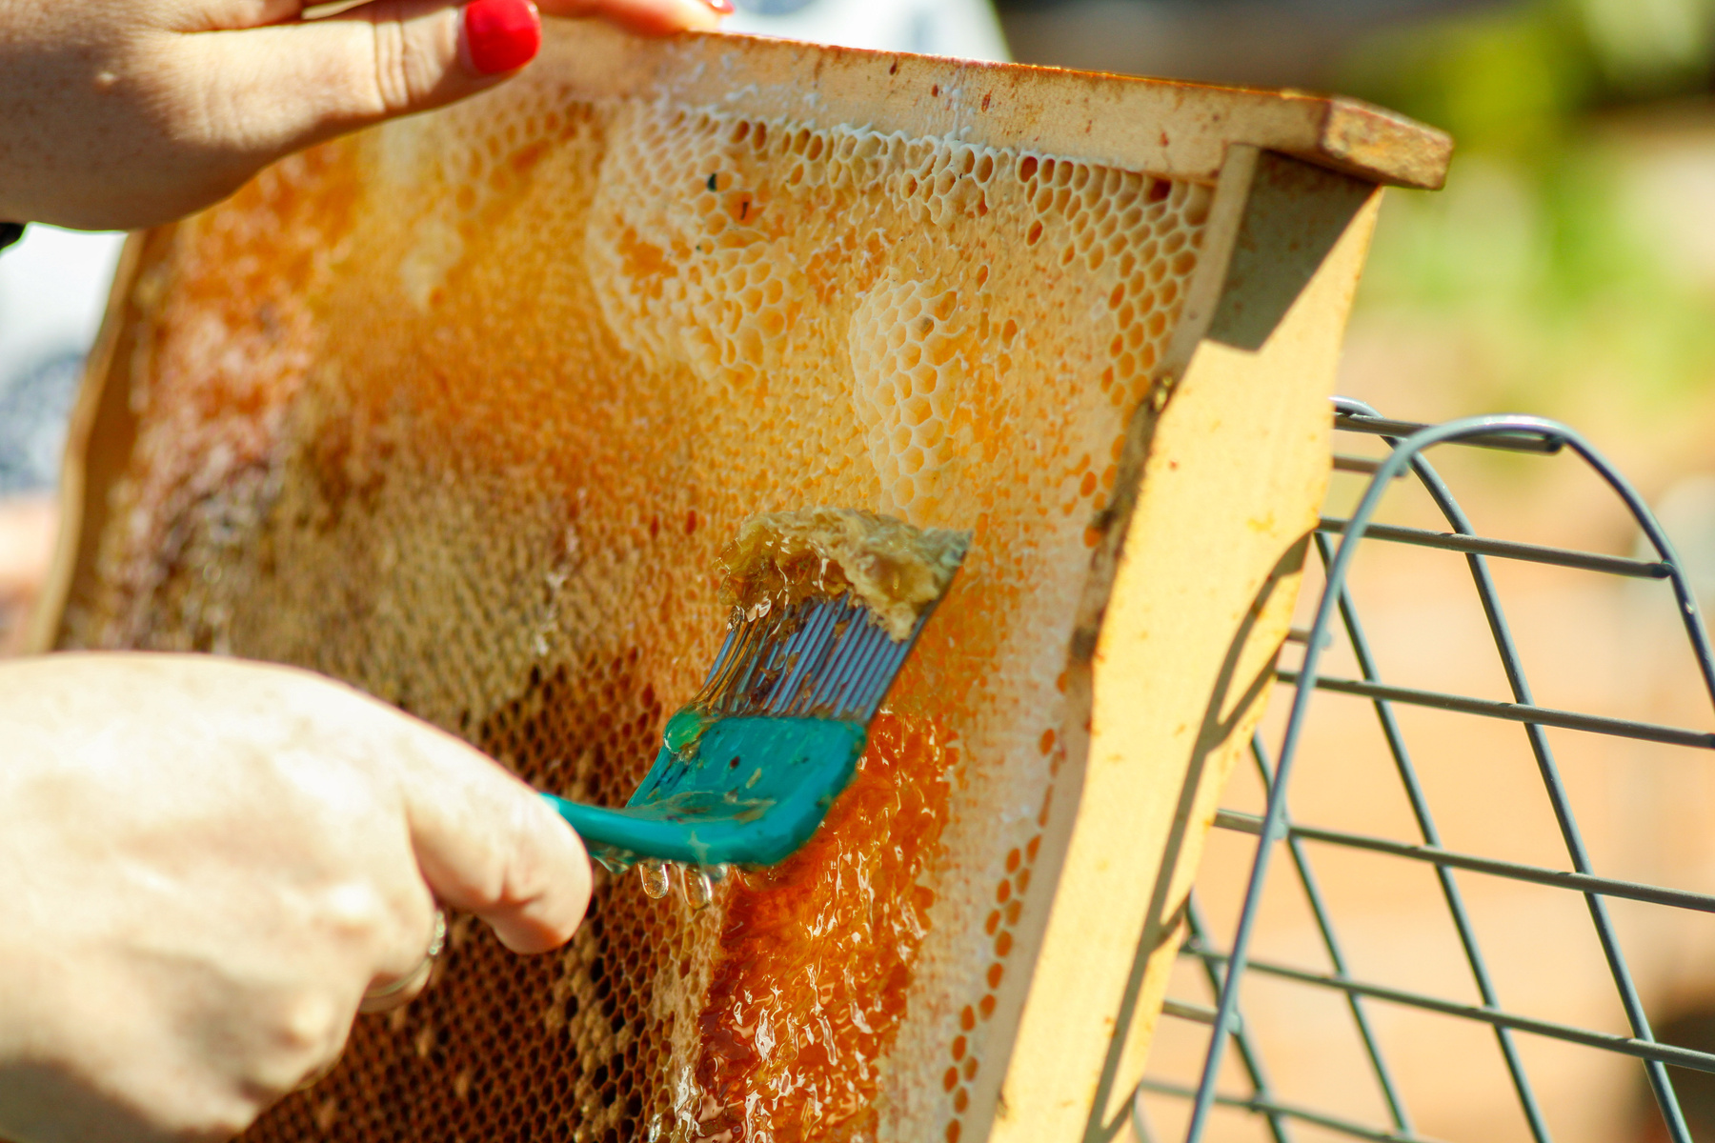
Place for Logo
Mission and Values
Support for Beekeepers, sustainability
We actively support local beekeepers and strive for maximum environmental sustainability in every aspect of our activities.
Our honey is free from antibiotics, and we ensure full traceability of each production batch.
Quote from the Director
"Our mission is to deliver pure, natural honey to every consumer while preserving nature and supporting beekeepers."
Antibiotic-Free

Slide 4
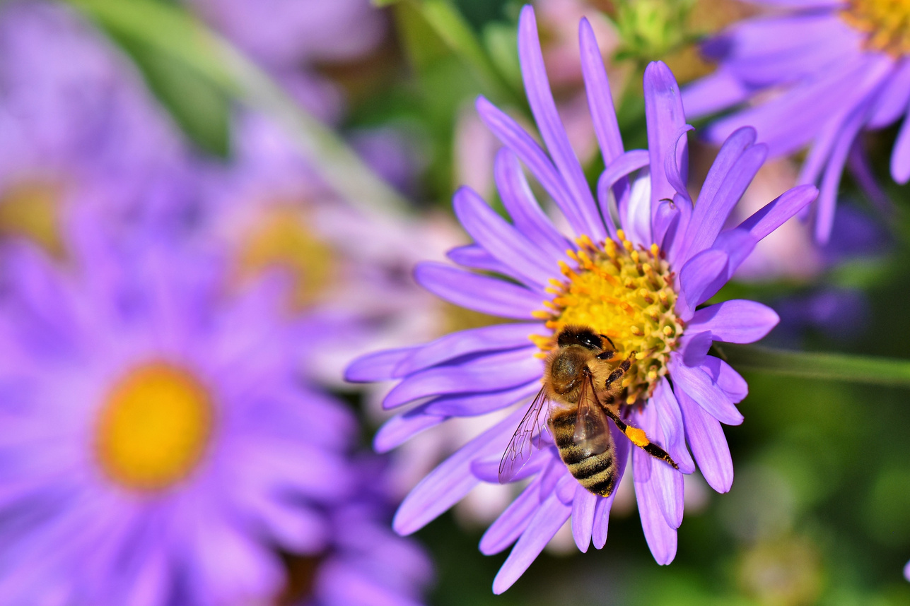
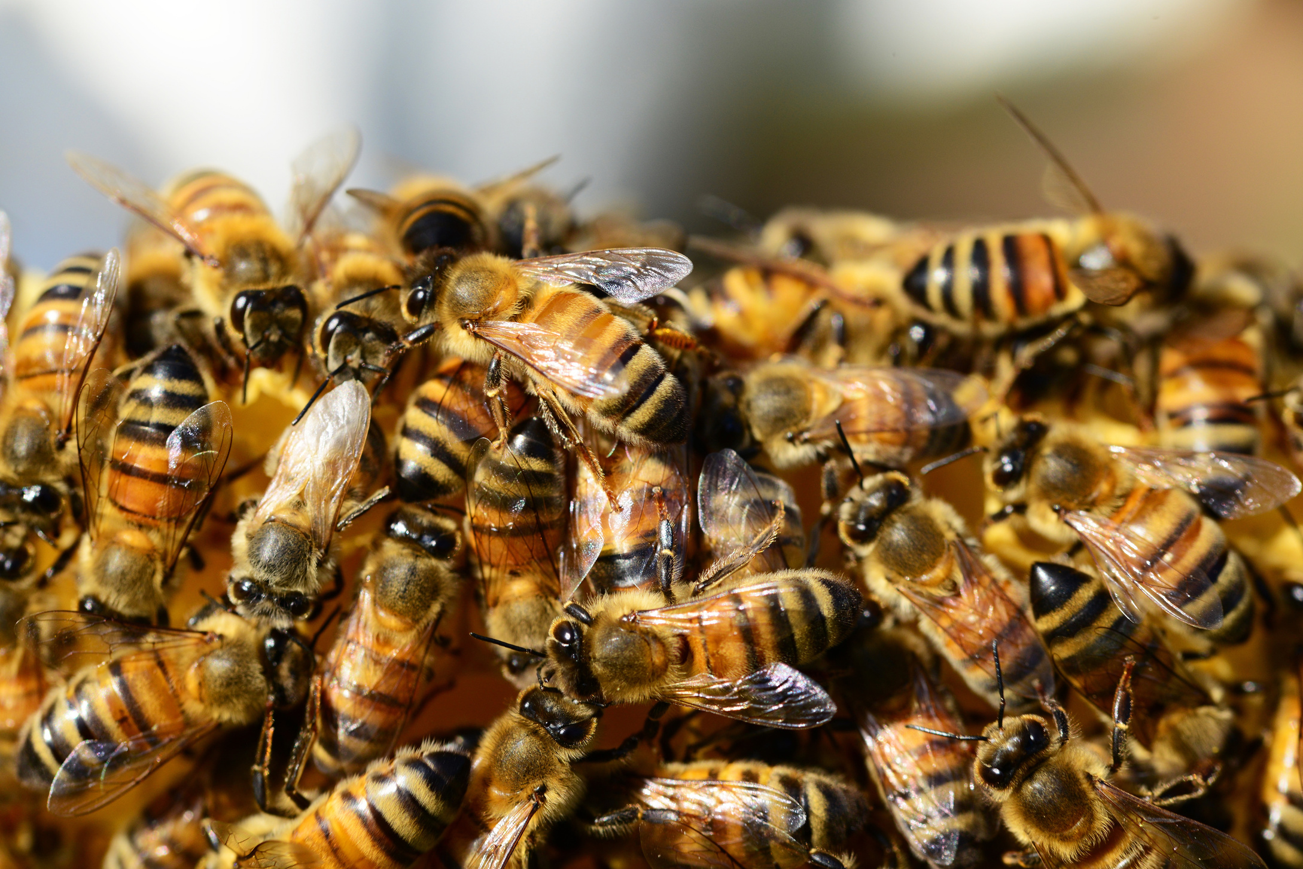
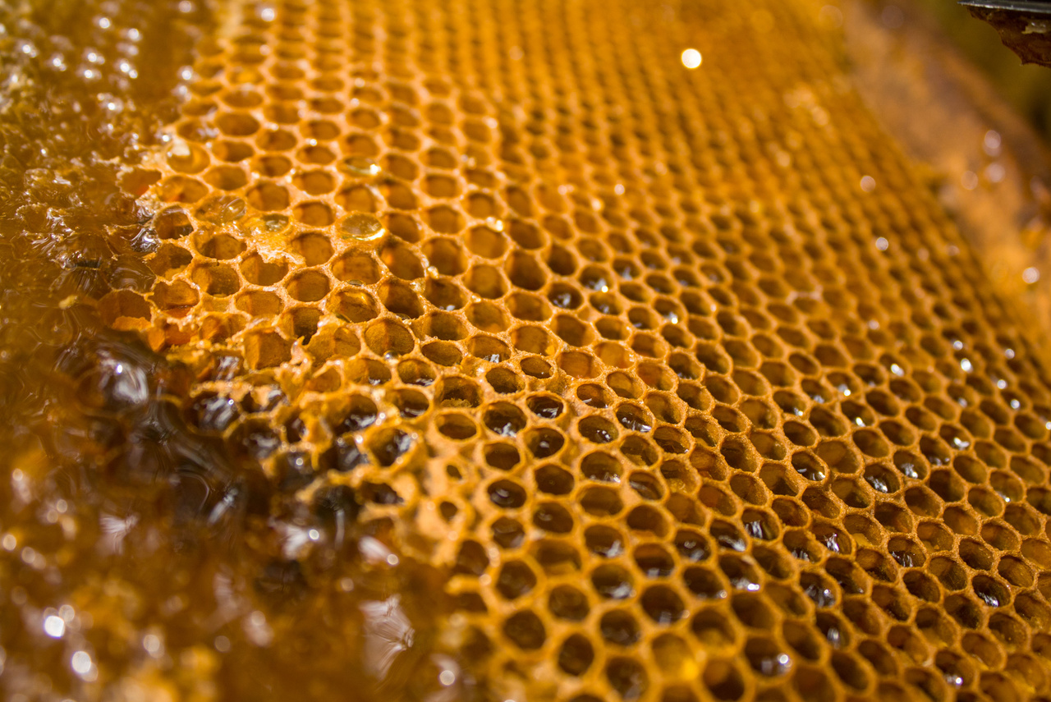
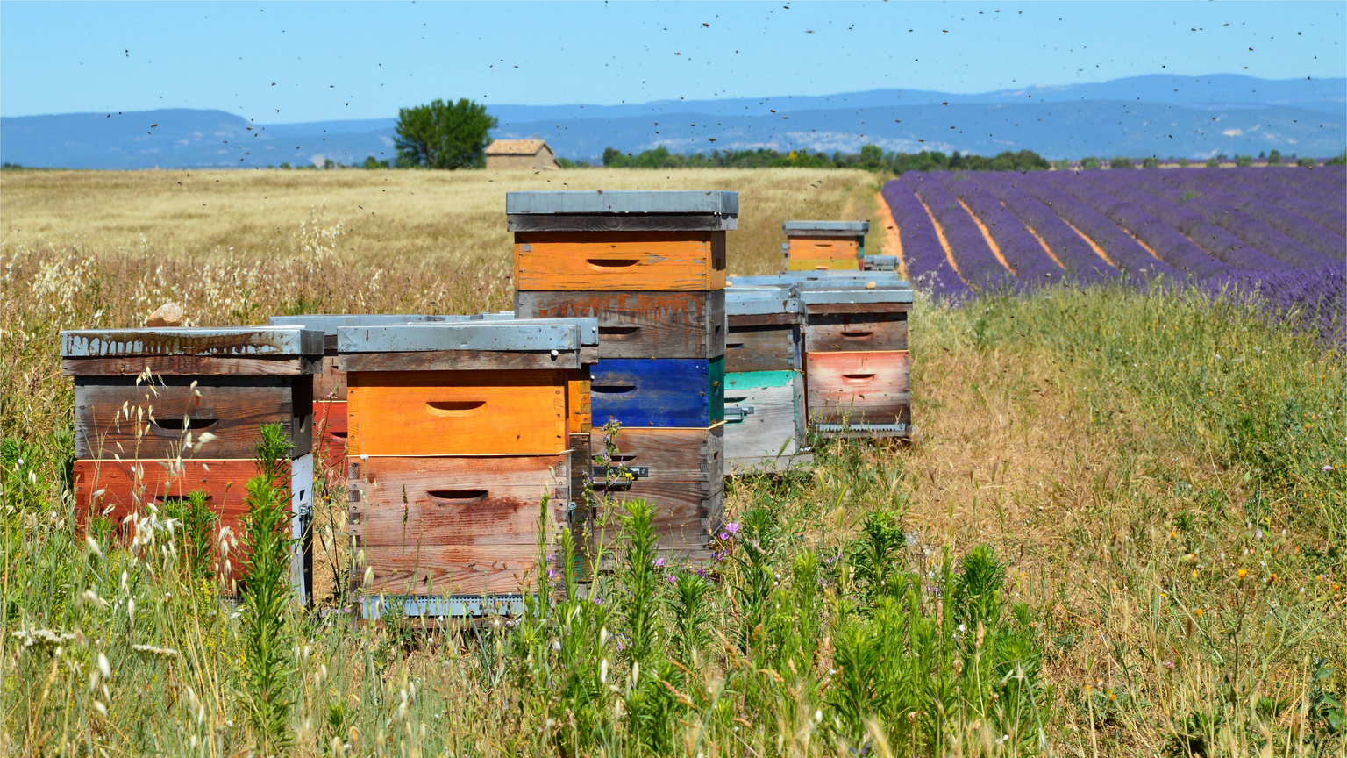
Place for Logo
Key
Advantages
Natural, No Additives, Laboratory Tested
Strict quality control at every stage, starting from laboratory analysis
Certified: Organic, ISO, Halal
Modern equipment enables us to process large volumes of honey while preserving its beneficial properties
International packaging standards
Full set of certificates confirming the quality and safety of our products

Slide 5
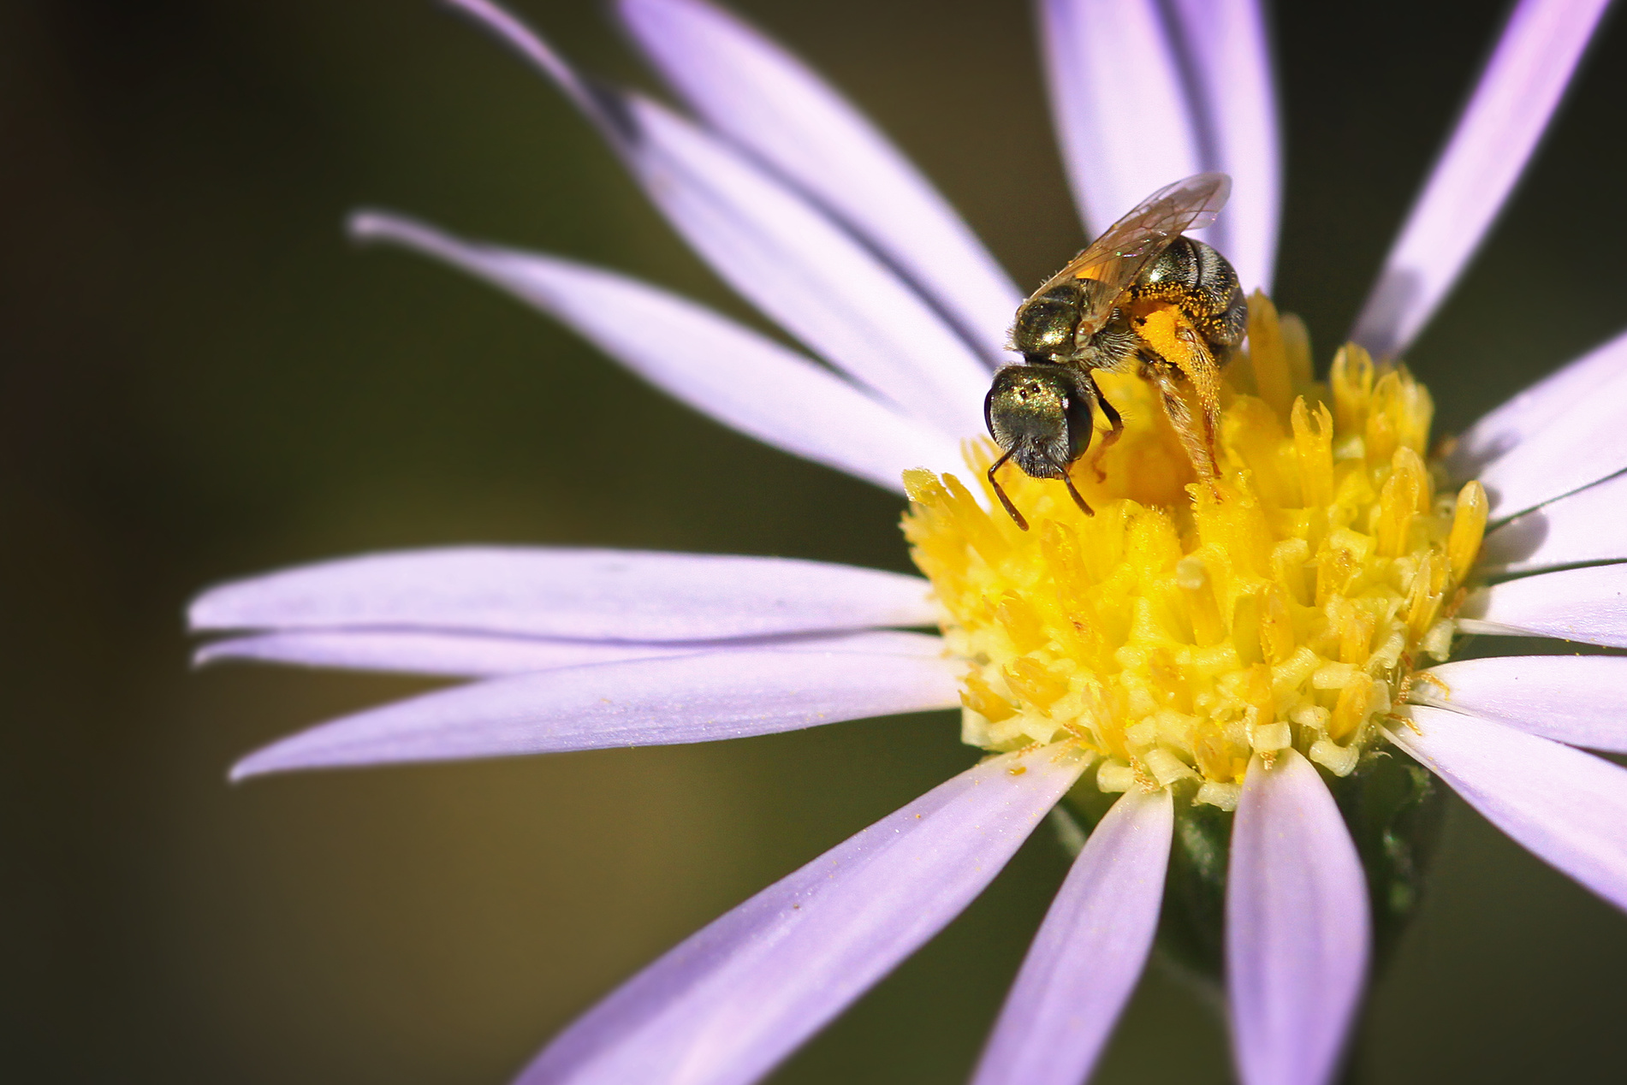
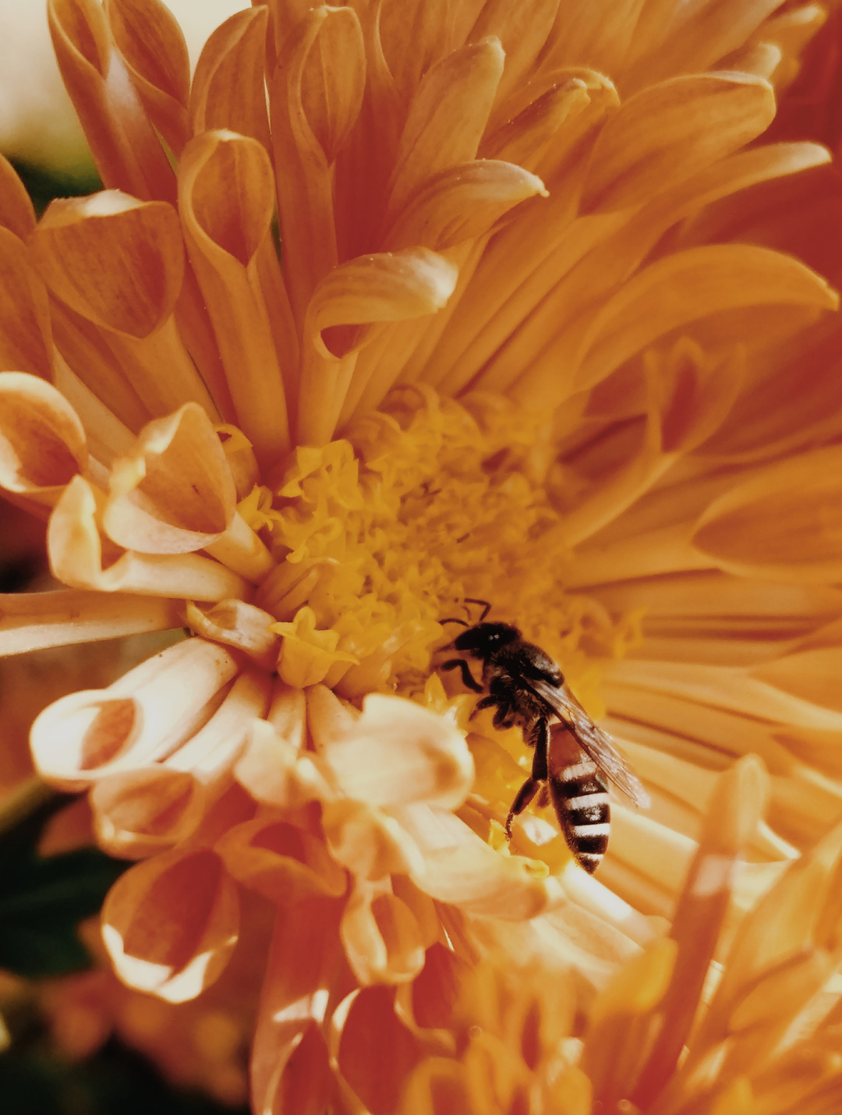


Place for Logo
Production and Technology
Laboratory & Quality Control
Our production processes include strict quality control at every stage, starting with laboratory testing.
Production Capacity
Modern equipment allows us to process large volumes of honey while preserving its beneficial properties.
Certificates & Packaging Standards
We adhere to international packaging standards and hold all necessary certificates confirming the quality and safety of our products.

Slide 6
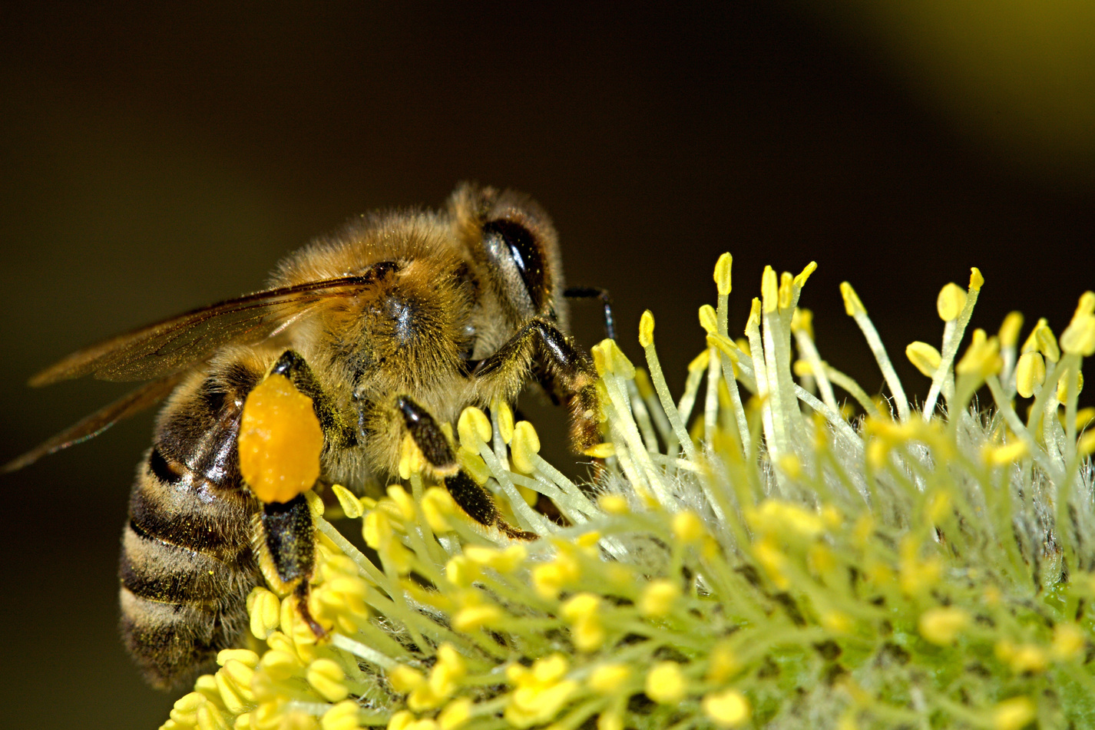
Place for Logo
Partner Portfolio
We are proud of our extensive portfolio of partners around the world, including Germany, Poland, the UAE, and other countries. We have received numerous positive reviews and have many successful collaboration cases with distributors.

Slide 7
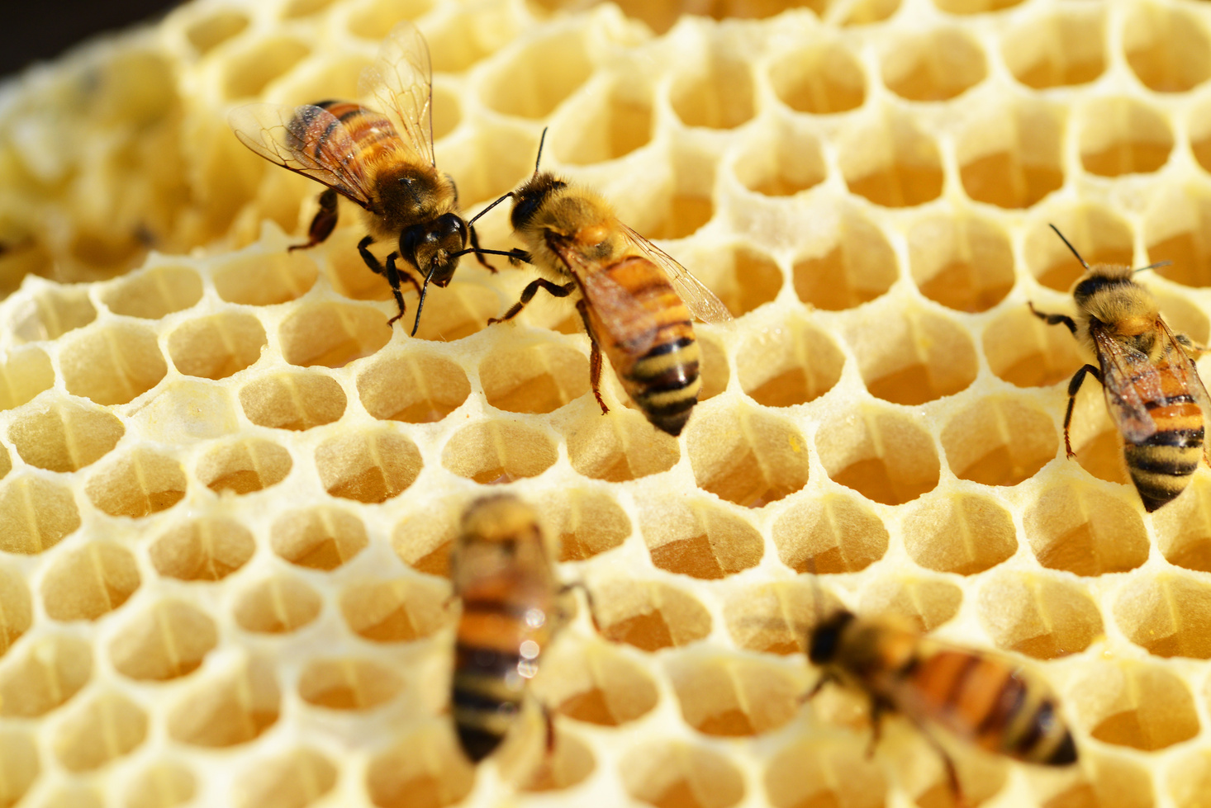
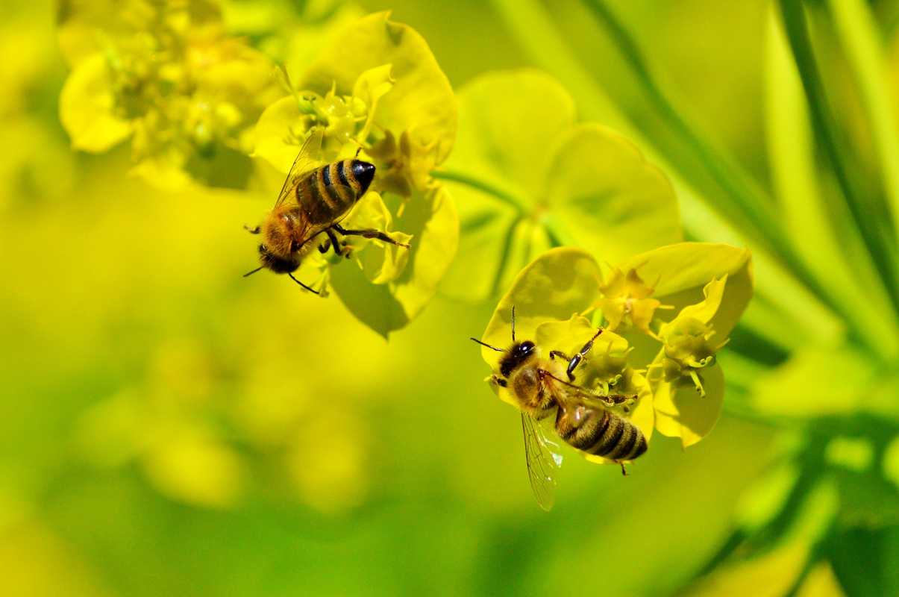



Terms of Cooperation
Place for Logo
Incoterms:
EXW, FOB, CIF, DDP
MOQ: 300 kg bulk / 500 pcs packaged
Samples, Price List & Custom Terms
We operate under various Incoterms: EXW, FOB, CIF, DDP, to ensure maximum convenience for our partners.
The minimum order quantity is 300 kg for bulk honey or 500 units for packaged products.
We are ready to provide product samples, a full price list, and discuss individual cooperation terms based on your needs.

Slide 8
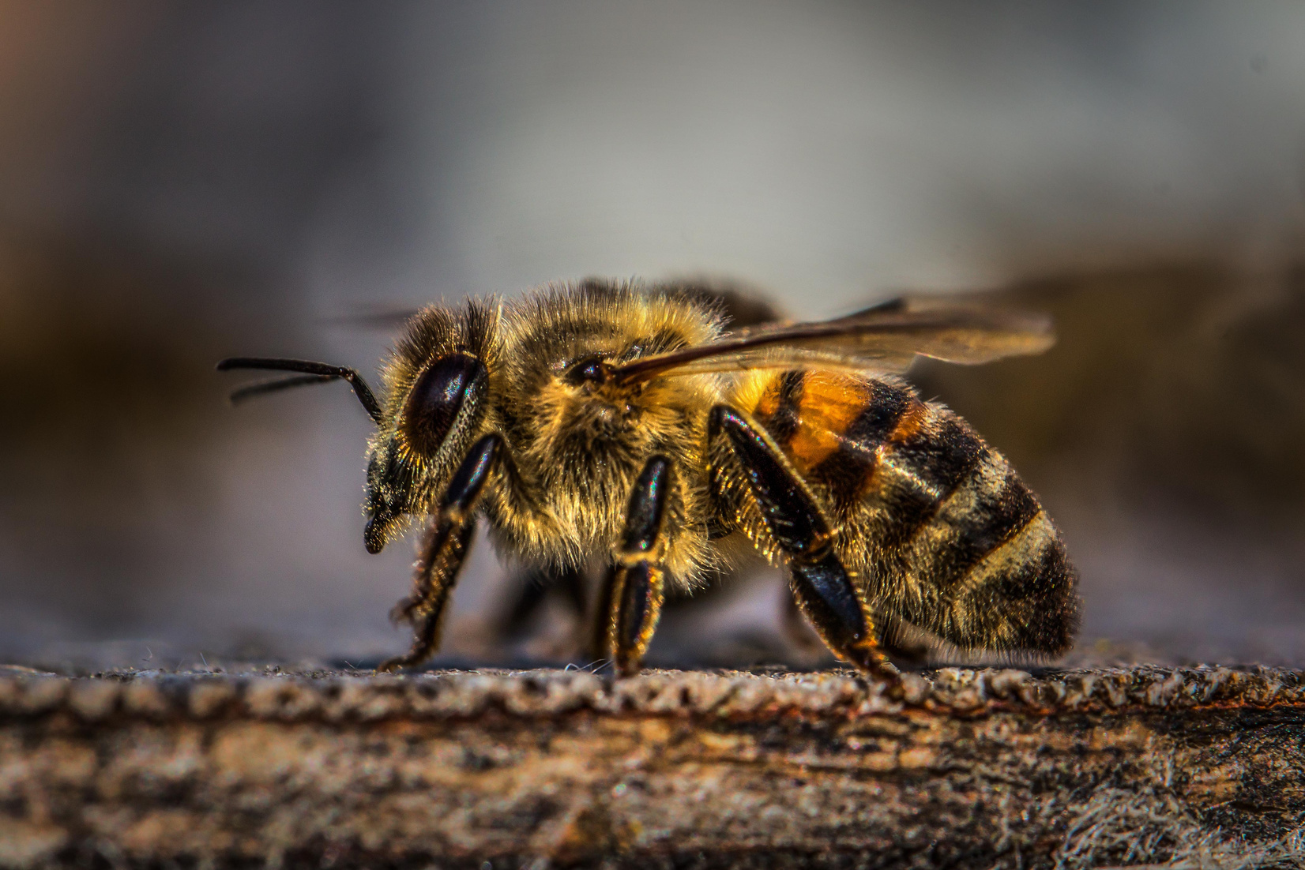
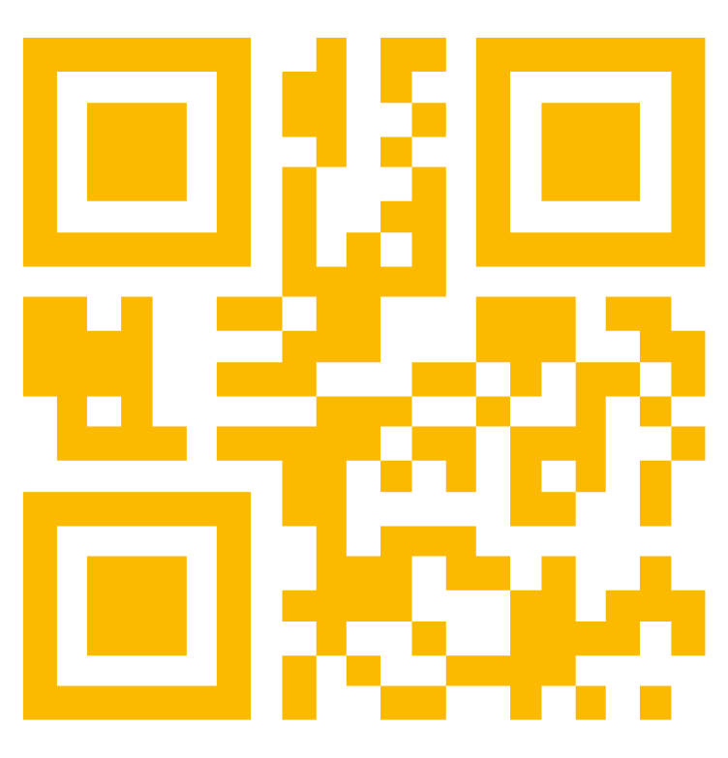
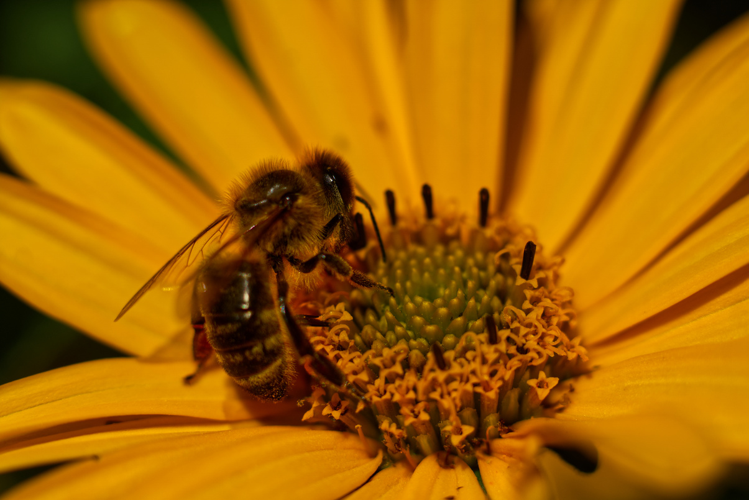
Place for Logo
Contact Information
Name, Position
Phone, E-mail, Website
QR Code for Catalog / Presentation / Video

