Slide 1


Place for Logo
PRESENTATION TITLE
[Company Name, Country/Region]
[Slogan: Unique Impressions from Kyrgyzstan]
[Contact Person: Full Name, Position]
WWW.YOURCOMPANY.COM

Slide 2
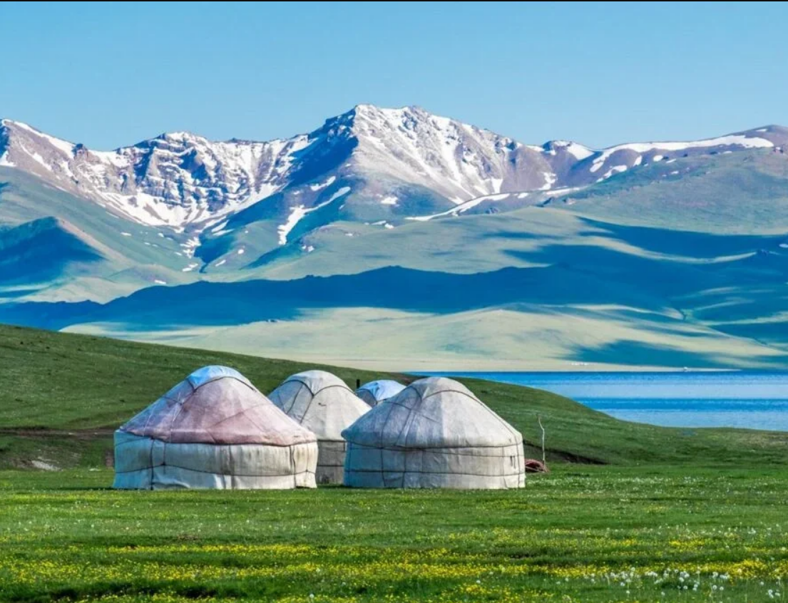
ABOUT
Place for Logo
us
AGENCY HISTORY & EXPERIENCE
We are a team of professionals with many years of experience in the tourism industry. Our agency was founded to showcase the unique beauty of Kyrgyzstan to the world and to provide every traveler with unforgettable experiences.
SPECIALIZATION: TOURS, DESTINATIONS, TYPES OF TRAVEL
We specialize in organizing individual and group tours across Kyrgyzstan, offering a wide range of destinations and types of travel — from mountain adventure tourism to cultural immersions into nomadic life.

Slide 3

MISSION & VALUES
Place for Logo
FOCUS ON QUALITY, SAFETY, AND LOCAL CULTURE
Our mission is to provide high-quality and safe travel services while deeply immersing our clients in the unique local culture of Kyrgyzstan.
QUOTE FROM THE DIRECTOR
SUPPORT FOR LOCAL COMMUNITIES & SUSTAINABLE TOURISM
We actively support local communities and follow the principles of sustainable tourism, contributing to the preservation of nature and cultural heritage.

Slide 4

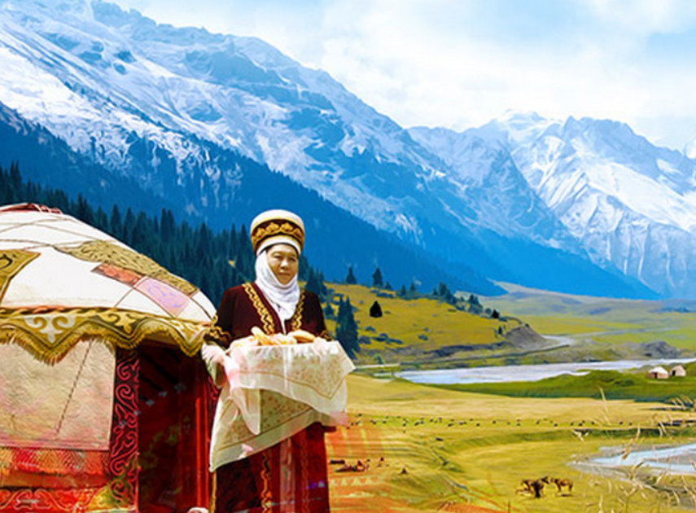

KEY
Place for Logo
ADVANTAGES
EXPERIENCE, LICENSES,
YEARS OF WORK
Our extensive experience, all required licenses, and impeccable reputation guarantee reliability and professionalism.
PERSONALIZED APPROACH, UNIQUE ROUTES
We offer a personalized approach to every client and design unique, rare routes that are not available to mass tourism.
RELIABLE PARTNERS, CLIENT FEEDBACK
We work only with trusted and reliable partners, as confirmed by numerous positive reviews from our clients.

Slide 5
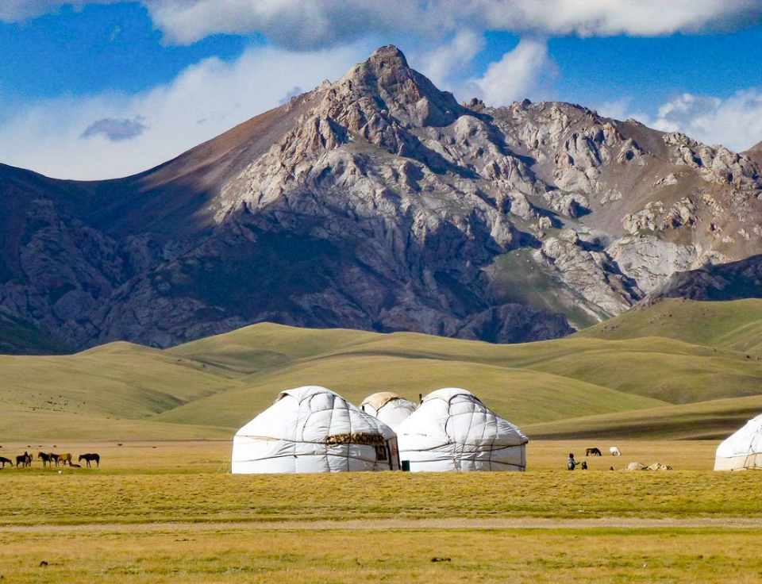
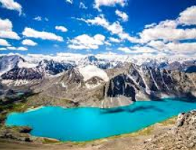
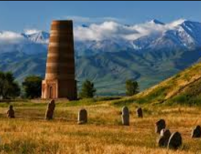
TOUR PRODUCTS / SERVICES
Place for Logo
MOUNTAIN TOURS
The mountain routes of Kyrgyzstan offer breathtaking views and unforgettable emotions. Travelers can enjoy fresh air, pristine nature, and peaceful silence away from the city. These tours are suitable both for active adventurers and for those who prefer a more relaxed vacation.
LAKES OF KYRGYZSTAN
The lakes of Kyrgyzstan attract visitors with their crystal-clear waters and picturesque landscapes. Here, beach leisure can be combined with active sports such as kayaking or fishing. A lake holiday is ideal for families, couples, and groups of friends.
CULTURAL TOURS
Kyrgyzstan is rich in history, traditions, and hospitality. Cultural tours allow travelers to experience local life, national cuisine, and traditional crafts. Such journeys are especially valued by tourists seeking authenticity and new impressions.

Slide 6

Place for Logo
LOGISTICS
& SAFETY
TRANSFER SERVICES
We provide comfortable and safe transfers throughout the entire route using a modern fleet of vehicles.
SAFETY BRIEFINGS
Before each tour, detailed safety briefings are conducted, and our guides are always ready to provide the necessary assistance.
MEDICAL SUPPORT
All our tours include medical insurance, and our guides are trained in first aid.

Slide 7
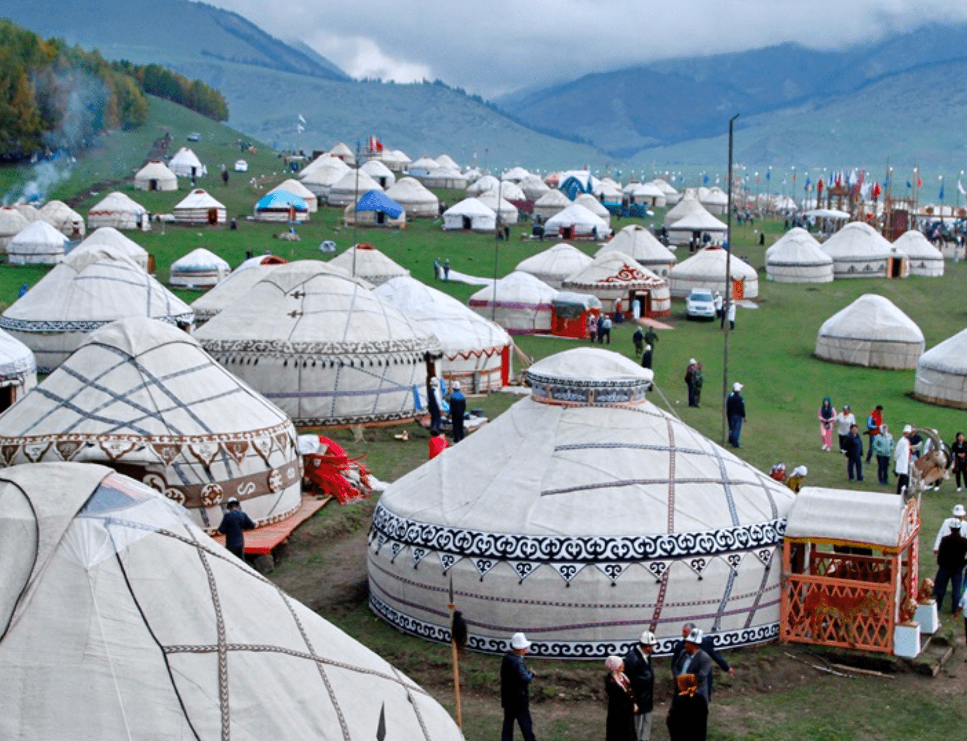
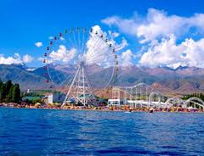
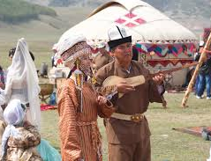
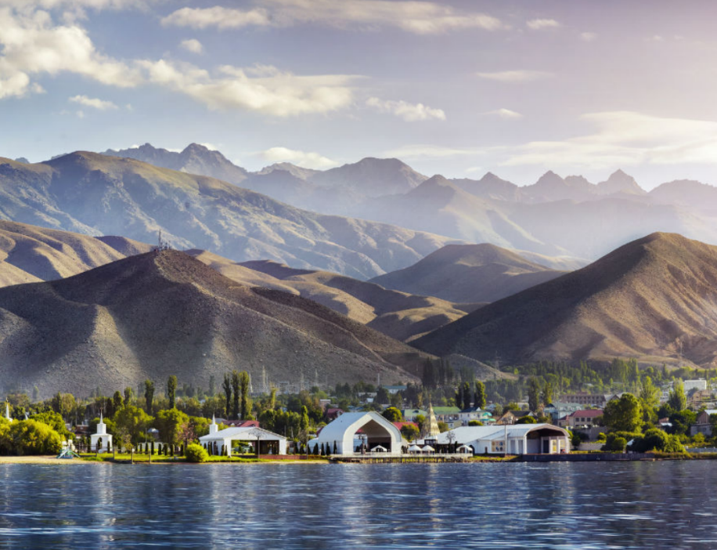
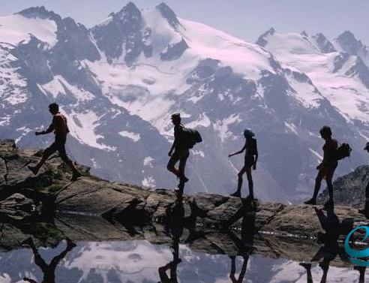
Place for Logo
PARTNER PORTFOLIO
We take pride in our extensive portfolio of partners, which includes leading hotels, airlines, and tour operators worldwide.
Our collaboration with international agencies enables us to offer unique cases and expand our client geography. We continuously analyze client and market statistics to improve our services and meet the highest standards.

Slide 8



Place for Logo
TERMS
OF COOPERATION
1
2
3
FLEXIBLE COMMISSIONS & BOOKING
We offer a flexible commission system and convenient booking conditions for our partners.
AGENCY AGREEMENTS & WHITE-LABEL TOURS
We sign agency agreements and provide the opportunity to organize white-label tours under your brand.
ONLINE BOOKING ACCESS & SUPPORT
We ensure online access to the booking system and provide 24/7 support for all our partners.

Slide 9
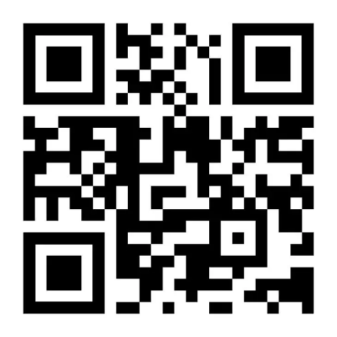
CONTACT
INFORMATION
Full Name
Position
QR code to the tour catalog
website
phone
email

