Slide 1

Place for Logo
PRESENTATION
TITLE
[Company Name, Country/Region]
[Slogan: Unique Impressions from Kyrgyzstan]
[Contact Person: Full Name, Position]
www.yourcompany.com

Slide 2

About us
Place for Logo
SPECIALIZATION & ESTABLISHMENT DATE
Our company specializes in software development and was founded in [founding date]. We offer cutting-edge solutions for businesses using the latest technologies.
OUR TEAM
Our team consists of highly qualified specialists with deep knowledge and extensive experience in various IT fields. We continuously grow and adopt new technologies.
TECHNOLOGY STACK & OFFICES
We use a wide range of technologies, including [technology stack]. Our offices are located in [region], allowing us to work efficiently with clients worldwide.

Slide 3
MISSION & VALUES
Place for Logo
RELIABILITY
We build long-term relationships with our clients based on trust and stability.
FLEXIBILITY
We adapt to the changing demands of the market and clients, offering customized solutions.
WORKING WITH INTERNATIONAL CLIENTS
We successfully collaborate with companies worldwide, ensuring high-quality services.
INNOVATION
We continuously explore new approaches and technologies to create cutting-edge solutions.
TRANSPARENCY
We provide full transparency at every stage of the project.

Slide 4

KEY ADVANTAGES
Place for Logo
OUTSOURCING / OUTSTAFFING
FLEXIBLE TEAMS
We offer flexible collaboration models, including outsourcing and outstaffing, to meet the unique needs of each client.
We build teams that can quickly adapt to changes and work efficiently on projects of any complexity.
B2B EXPERIENCE
SECURE DEVELOPMENT
Our extensive experience in the B2B sector allows us to create effective solutions that deliver real business value.
We pay special attention to security at every stage of development, ensuring the protection of data and systems.
NDA
GUARANTEES
SCALABILITY
We strictly adhere to Non-Disclosure Agreements (NDA), guaranteeing the confidentiality of all information.
We provide guarantees for all our services, confirming the high quality and reliability of our solutions.
Our solutions are easily scalable, allowing them to grow alongside your business.

Slide 5
Place for Logo
PRODUCTS / SERVICES
WEB
Development of high-performance web applications and websites.
MOBILE
Creation of native and cross-platform mobile applications.
QA
Ensuring software quality through comprehensive testing.
AI
Implementation of artificial intelligence and machine learning solutions.
DevOps
Optimization of development and operations processes using DevOps practices.

Slide 6
Place for Logo
Technologies & processes
1
2
3
TECHNOLOGY STACK
We use advanced technologies and frameworks to create reliable and scalable solutions.
SCRUM, KANBAN, AGILE
We apply flexible development methodologies such as Scrum, Kanban, and Agile for effective project management.
CI/CD
Continuous Integration and Continuous Delivery (CI/CD) ensure fast and reliable product delivery.

Slide 7

Place for Logo
PROJECT PORTFOLIO
100K+
USERS
Our projects serve hundreds of thousands of users worldwide.
50+
SERVERS
We manage over 50 servers to ensure uninterrupted operation.
1M+
SESSIONS
Our systems handle over one million user sessions every month.

Slide 8
Place for Logo
Terms of cooperation
1
2
3
COLLABORATION
MODELS
We offer various collaboration models: Time & Material, Fixed Price, and Dedicated Team, to suit your needs and budget.
COMMUNICATION & TRACKING TOOLS
COMMUNICATION & TRACKING TOOLS
IMPLEMENTATION TIMELINES & PROJECT STAGES
We clearly define implementation timelines and break the project into stages so you are always aware of the progress and can plan your resources accordingly.

Slide 9
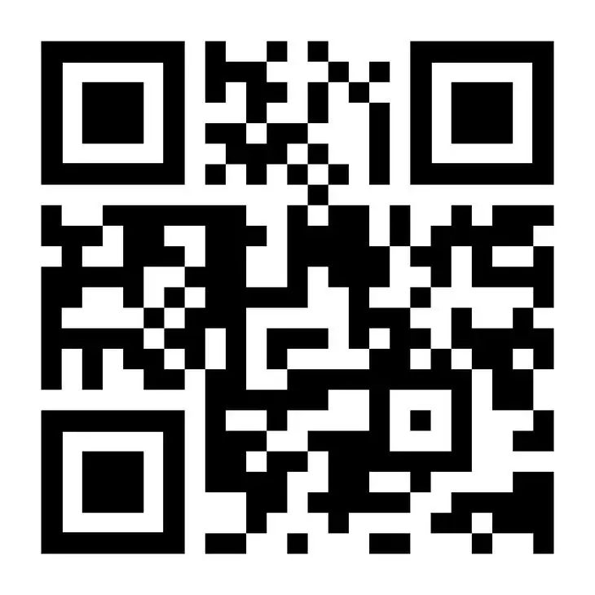
Place for Logo
Contact information
Website:
yourcompany.com
Full Name: Please provide full name
Position: Please provide position
Phone: Please provide phone number
Email: Please provide email address
Portfolio Link:

